Slide 1
On Beyond Objects Programming in the 21th century COMP 590-059 Fall 2024
David Stotts
Computer Science Dept
UNC Chapel Hill

Slide 2
Abstract Data Types
(ADTs)

Slide 3
Abstract Data Types (ADT)
This segment will cover how to define the
Behavior
of a data structure without being bogged down in the details of an
Implementation
of the operations

Slide 4
ADT is a definition
one ADT definition
like Point
will be correct for
many implementations
like CartesianPoint, PolarPoint, etc.
Define the behavior once, then
it guides implementation
provides an oracle for deciding correctness of code ( by testing, or maybe “proving” )

Slide 5
Abstraction
An abstraction is a “model” … a simplification of something complex
We take out some detail to show the basics of something in simple form
Details we remove are irrelevant to the aspects we wish to emphasize or explain in the model

Slide 6
Model of UNC
enroll
Do 4 or 5 times
Pay tuition
Take fall classes
Take spring classes
Get 1.7 mil emails from Alumni Assoc
graduate

Slide 7
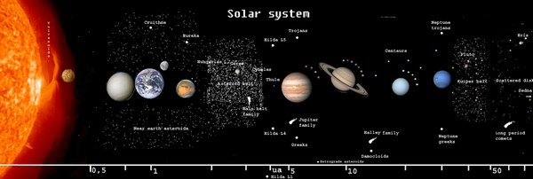
Model of the Solar System
What can we study here?
What can we not study?

Slide 8
Model of the Solar System

Slide 9
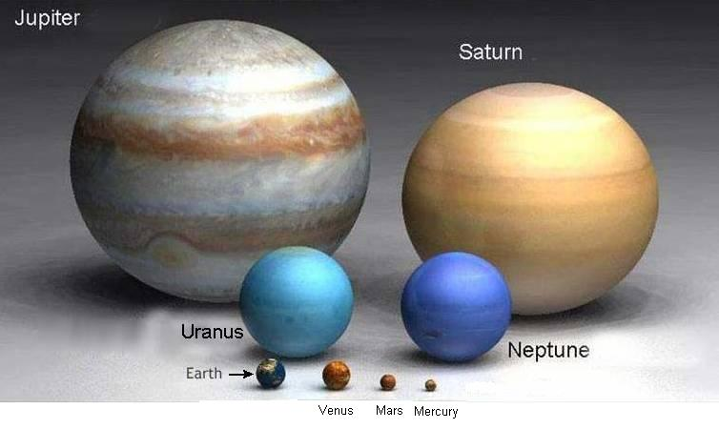
Model of the Solar System

Slide 10
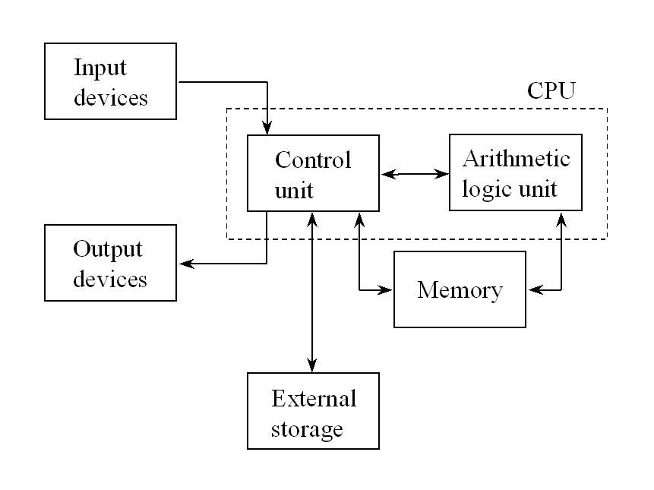
Von Nuemann Model of a Computer

Slide 11
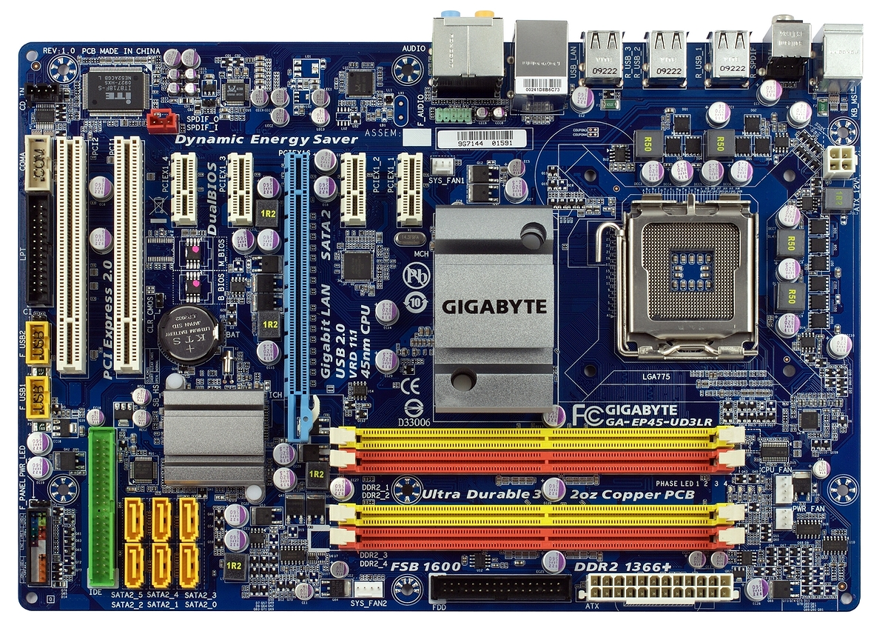
Network,
cloud
USB
Disk drives, DVD
CPU
regs
cache
Main memory
RAM

Slide 12
How can Data be Abstract?
We want a model … ADT is a model
Left out:
details related to implementation in any particular programming language
Left in:
changes made to state of the data (the values and their relationships, their organization) when various operations are performed

Slide 13
Class experiment
Lets examine a line, at some service place like the DMV
We want the service to be First come, First served
How can we do this?
What is the behavior?
What is the implementation?
Volunteers?

Slide 14
How can Data be Abstract?
We think of a data structure as being more that just data
We think of it as data values together with behavior… operations that manipulate the data values
So for every operation we want to define a function that will transform its arguments into its return values

Slide 15
How can Data be Abstract?
We said an ADT is collection of data values, and the operations that manipulate those values (this is an algebra in formal terms )
Think integer algebra… a collection of data values (integers) and operations on integers ( +, -, /, *, =, < )
It is also a Type in Java terms… an ADT is a Type… any Class can be thought of as a Type.
This is why we often say “x is of type Point” when we have “Point x = new Point(); “ in the code
We define syntax, and semantics (behavior)
We define interface, and implementation (informally)
We define signature, and axioms (formally)

Slide 16
So… what is the Behavior?
We can use an informal behavior definition
Write in English what each operation is supposed to do
Try to describe what transformation should happen to the state of the data
Include any exceptions or error conditions and what state the data is left in when such conditions occur
Be as unambiguous as possible
This is what we do in your assignments
We give you an Interface (or 2 or 3) for syntax
We give you an English description of the semantic (behavior) we need for each operation in the ADT to exhibit
Then you write code (implementation) that matches the abstraction
You test to decide if the code matches the informal behavior definition

Slide 17
Let’s define a Stack ADT
public interface Stack {
void push (int elt) ;
void pop (); // or maybe int pop();
int top();
int size();
// Stack Stack(); // don’t forget the constructor
// we don’t write this in a Java
// interface but it is there
}

Slide 18
Stack
LIFO: last in first out
new()
push(73)
push(8)
push(-61)
push(12)
top
12
-61
size is 4
8
73

Slide 19
Stack
pop( )
12
top
-61
top
-61
8
8
size is 3
73
73

Slide 20
So… what is the Behavior?
Consider push, pop, top, size (and new)
We might say (in a lot of words) things like
When we get a new stack it is empty (meaning size is 0)
When we push something on the stack the size goes up 1
The elements in the stack before the push are all there after, and in the same order
Top tells us what element in the most recent one pushed
Top does not change the size of the stack
When we pop something off, size goes down 1 ( … really?? )
Pop on an empty stack does… ???
Top on an empty stack does … ???
The element that was pushed onto the stack is at the top (meaning top returns that element after the push) ( redundant?? )
Pop removes the top element and leaves the rest of the stack unaltered

Slide 21
more… what is the Behavior?
In Java,
one behavior is the Implementation code
But code… is code dependent ( !!! )
Say we implement the interface two different ways ( like we did in CartesianPoint and PolarPoint )
How can we be sure they both behave like a Point ?
Or they behave like each other (at some level)?
Here, let’s say we have a LinkedStack and an ArrayStack
How can we be sure they both behave like a Stack ?
We need a common, single, abstract behavior definition
abstract meaning not code, and not making reference to any code structures that might appear in implementations

Slide 22
Another Approach
We can use a formal behavior definition
Define in a mathematical notation what each operation is supposed to do
The formal notation is a form of implementation in “math” code
Guttag (1978) used algebraic axioms
Axiom is a statement of equality between 2 forms or versions of a data structure
Uses a functional notation (not an OO notation like Java method calls)
So there is a slight mismatch between OO thinking and Functional thinking…

Slide 23
Functional Notation
Using functional notation to define ADT ops …
We think of ADTs as a model for objects in programs
Object has persistent state and a method call alters that state
Function takes input and produces output, like a black box… no state remains
An ADT op will take in an ADT element (like an abstract stack) and return a (possibly altered) ADT element (or some other data like Boolean )
So don’t get tripped on notation… consider the concepts being abstracted and defined

Slide 24
Using a Stack Object
var stk = New STACK( );
print( stk.size( ) );
stk.push(73);
stk.push(8);
stk.push(-61);
stk.push(12);
print(stk.size( ) );
stk.pop( );
print( stk.size( ) );
print( stk.top( ) );

Slide 25
Functional view
stk = new ( );
print ( size ( stk ) );
stk = push(stk,73);
stk = push(stk,8);
stk = push(stk,-61);
stk = push(stk,12);
print(size(stk));
stk = pop(stk);
print(size(stk));
print(top(stk));

Slide 26
Guttag’s Method
First develop the functional signature
list of all operations, the types of the arguments to them, and the types of the results
Next provide an axiomatic specification of the behavior of each operation (method)
Today we will use a math notion to get used to the idea of specifying ADTs
Later we will use the ML programming language (and get executable specifications)

Slide 27
Example: STACK of Int
Signature
new: → STACK
push: STACK x Int → STACK
pop: STACK → STACK
top: STACK → Int
size: STACK → Nat (natural number)
empty: STACK → boolean
This is like Interface in Java

Slide 28
Example: STACK of Int
Axioms for Behavior
Idea is to write an equation (axiom) giving two equivalent forms of the data structure
pop ( push ( new(), -3 ) ) = new( )
LHS same as RHS
pop(push(push(new(), 7) ,4) ) = push(new(),7)
Similar to axioms in integer algebra
2 + 2 + 3 = 2 + 5

Slide 29
Example: STACK of Int
Axioms for STACK Behavior
Ex: size( new() ) = 0
Ex: size( push( new(), 6 ) ) = 1
Ex: top ( push ( push ( new(), 3 ), -8 ) ) = -8
Ex: pop ( push ( new(), -3 ) ) = new()
Ex: top(pop(push(push(new(),2),7))) = 2
More?
Will this end?
How can we capture all possible behavior?

Slide 30
Back to STACK of Int
top
How can we create this element of type STACK ?
push( push( new,8 ), 5)
push( push( pop ( push(new,12) ), 8), 5)
pop( push( push( push( new, 8), 5), 9) )
push( push( pop( push( pop( new ), 8), 8), 8), 5)
push( pop( pop( push( push( push( new, 8), 5), -10) ) ), 5)
unlimited ways…
5
Which is the “easiest way” to construct it?
-- the first one… no pop use
Can any ST in STACK be built with no “pop” use?
-- yes… sequence of push on a new
8
push and new are “canonical” operations

Slide 31
Back to STACK of Int
A canonical operation is one that is needed if your goal is to generate ALL possible stack values by calling successive operations
A non-canonical op is one that is not needed… in other words, all uses of it can be replaced by some use of others (canonicals).
Ex: push ( pop ( push ( new(), 6) ), 3)
is the same as
push ( new(), 3 )
the pop operation is not needed to create the
stack with a single element, the “3”

Slide 32
Back to Guttag
Follow this procedure to generate set of axioms that are finite and complete
Find canonical operations
Make all LHS for axioms by applying each non-canonical op to a canonical op (cross product)
Use your brain and create an equivalent RHS for each LHS

Slide 33
STACK (cont.)
STACK ops: new, push, pop, top, size
Canonicals: new, push
Note that all ops that return something other than STACK are non-canonical (top, size)
Canonicals are ops that construct values, and even so only the necessary ones
pop constructs… it returns a STACK
But we showed it can be successfully avoided with judicious use of new and push

Slide 34
STACK (cont.)
LHS of axioms (non-canon applied to canon)
size( new( ) ) = ?
size( push( S, i ) ) = ?
pop( new( ) ) = ?
pop( push( S, i ) ) = ?
top( new( ) ) = ?
top( push( S, i ) ) = ?

Slide 35
STACK (cont.)
LHS of axioms (non-canon applied to canon)
size( new( ) ) =
size( push( S, i ) ) =
pop( new( ) ) =
pop( push( S, i ) ) =
top( new( ) ) =
top( push( S, i ) ) =
0
size( S ) + 1
new( )
S
err
i

Slide 36
Notes
How do the axioms specify behavior like “when we pop a STACK the size goes down by one” ?
Think of STACK values as sequences of ops
push( pop( push( push(new( ),6), 3 ) ), 4 )
Think of axioms as rules for rewriting these sequences into simpler form
pop( push(S,i) ) = S
lets us rewrite by pattern matching parts of the sequence with variables in the axiom

Slide 37
Notes
Lets us rewrite by pattern matching parts of the sequence with variables in the axiom
STACK: push( pop( push( push(new(),6), 3 ) ), 4 )
AXIOM: pop( push( S, i ) ) = S
In the STACK value this part is S from the AXIOM
S matches push(new(),6)
Axiom rewrites the STACK as
push( push( new(), 6) , 4 ) size is 2
3 pushes in STACK value, but size is 2 when done

Slide 38
Notes
Why non-canonical applied to canonical?
Canonical op constructs (or extends) a STACK
Non-canonical op then measures it… tells us something about its state
“We just built a STACK by using push on some previous STACK.. what happens to the size? what item is now on top? “ etc.

Slide 39
QUEUE
FIFO: first in, first out
new( )
enq(4)
enq(-31)
enq(15)
tail
front
size is 3
4
31
15

Slide 40
QUEUE
front
tail
4
31
15
deq ( )
front
tail
31
15
size is 2

Slide 41
Example: QUEUE of Int
Signature
new: → QUEUE
enq: QUEUE x Int → QUEUE
deq: QUEUE → QUEUE
front: QUEUE → Int
size: QUEUE → Nat (natural number)
Canonical ops
Note: we never ask “what is on the back of the Queue?”
This is not an operation in the abstract behavior
(it is something an implementation can reveal)

Slide 42
QUEUE (cont.)
LHS of axioms (non-canon applied to canon)
size( new( ) ) = ?
size( enq( Q, i ) ) = ?
deq( new( ) ) = ?
deq( enq( Q, i ) ) = ?
front( new( ) ) = ?
front( enq( Q, i ) ) = ?

Slide 43
QUEUE (cont.)
LHS of axioms (non-canon applied to canon)
size( new( ) ) = 0
size( enq( Q, i ) ) = size(Q) + 1
front( new( ) ) = err
front( enq( Q, i ) ) = ite( Q=new( ), i, front(Q) )
deq( new( ) ) = new()
deq( enq( Q, i ) ) =
ite( Q=new( ), Q, enq( deq(Q), i) )

Slide 44
Functional vs. Java
The signatures have been expressed in functional notation (since axiomatic definitions are functional)
Functional signatures help when “implementing” ADT behavior is a functional language like ML (or LISP)
Java is not functional, so signature will look a little different

Slide 45
STACK of Int Signature (Java)
new: → STACK
push: Int → void
pop: → void
top: → Int
size: → Nat (natural number)
OR… maybe something like this
new: → STACK
push: Int → Boolean
pop: → Boolean (or maybe Int)
top: → Int
size: → Nat

Slide 46
QUEUE of Int Signature (Java)
new: → QUEUE
enq: Int → void
deq: → void
front: → Int
size: → Nat (natural number)
OR… maybe something like this
new: → QUEUE
enq: Int → Boolean
deq: → Boolean (or maybe Int)
front: → Int
size: → Nat (natural number)

Slide 47
Compare Signatures…
Its all syntax… no meaning (behavior)… so let’s just name the ops generically
These are mostly the same syntactically
They differ in the return type of the constructor
STACK
new: → STACK
add: Int → Boolean
remove: → Boolean (or maybe Int)
next: → Int
size: → Nat (natural number)
QUEUE
new: → QUEUE
add: Int → Boolean
remove: → Boolean (or maybe Int)
next: → Int
size: → Nat (natural number)
But Stack and Queue are different ADTs
So where is the difference?
It must be in the behaviors
In the implementations
Stack and Queue have different behaviors
Stack: LIFO
Queue: FIFO

Slide 48
“Executable” Axioms
Let’s examine how to write these ADT specs using the functional programming language ML
with ML we can then “execute” the specs and see if the behavior is what we envision
You can download and install ML on your computer
or, online ML interpreters:
https://www.tutorialspoint.com/execute_smlnj_online.php
https://sosml.org/

Slide 49
Consider this Stack ADT
new: → STACK
push: STACK x Int → STACK
pop: STACK → STACK
top: STACK → Int
size: STACK → Nat
empty: STACK → boolean
2 canonical ops
4 non-canonical ops
4 x 2 makes 8 axioms
size( new( ) ) = 0
size( push( S, i ) ) = size(S) + 1
pop( new( ) ) = new()
pop( push( S, i ) ) = S
top( new( ) ) = error
top( push( S, i ) ) = i
empty( new( ) ) = true
empty( push( S, i ) ) = false
Axioms
The Meaning of the ops
The Behavior

Slide 50
Express the ADT in ML
ML code for the Stack of Int ADT
We write data constructor definitions for each canonical op
datatype STI = New | push of STI * int ;
We write one partial function for each axiom
fun pop (New) = New
| pop (push(S,i)) = S ;
Implements axioms
pop( new( ) ) = new( )
pop( push( S, i ) ) = S

Slide 51
Express the ADT in ML
We write one partial function for each axiom
fun size (New) = 0
| size (push(S,i)) = size(S)+1;
exception topEmptyStack;
fun top (New) = raise topEmptyStack
| top (push(S,i)) = i ;
Implements axioms
size( new( ) ) = 0
size( push( S, i ) ) = size(S) + 1
top( new( ) ) = error
top( push( S, i ) ) = I

Slide 52
Express the ADT in ML
That’s it… run the ML interpreter on the code
Try the semantics…
Make some stacks and see how the ops perform
Test your “implementation”,
which tests the behavior specified in the axioms
This works because Guttag Axioms are functional
and ML is a functional programming language

Slide 53
Demo the ML Interpreter
Online ML interpreters:
https://www.tutorialspoint.com/execute_smlnj_online.php
https://sosml.org/

Slide 54
END

