Slide 1
On Beyond Objects Programming in the 21th century COMP 590-059 Fall 2024
David Stotts
Computer Science Dept
UNC Chapel Hill

Slide 2
What comes after OO?
Concepts and practices from research
that may or may not be
in general use

Slide 3
Bit of Historical Review
Before we study what else is out there beyond OO,
Let’s see how we got to where we are today

Slide 4
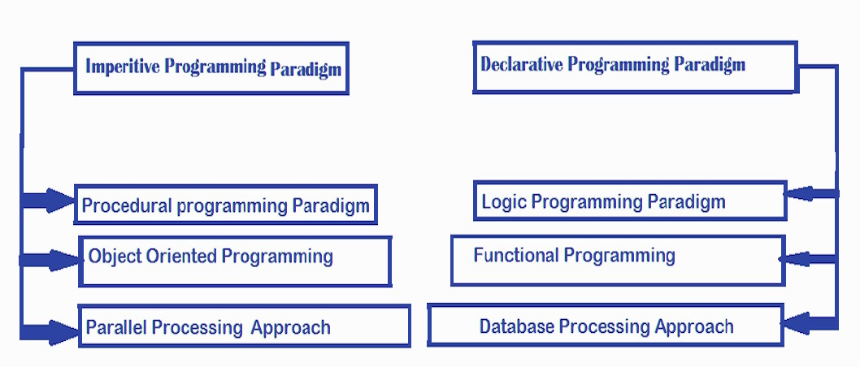
Programming Paradigms
https://www.geeksforgeeks.org/introduction-of-programming-paradigms/

Slide 5
summarized in this table:
Differences in terminology
Programming Paradigms ( source )
Paradigm | Description | Main traits | Related paradigm(s) | Critique | Examples
Imperative | Programs as statements that directly change computed state (datafields) | Direct assignments, common data structures, global variables |  | Edsger W. Dijkstra, Michael A. Jackson | Fortran IV, Basic, C, C++, Java, Kotlin, PHP, Python, Ruby
Structured | A style of imperative programming with more logical program structure | Structograms, indentation, no or limited use of goto statements | Imperative |  | C, C++, Java, Kotlin, Pascal, PHP, Python
Procedural | Derived from structured programming, based on the concept of modular programming or the procedure call | Local variables, sequence, selection, iteration, and modularization | Structured, imperative |  | C, C++, Lisp, PHP, Python Fortran 77
Object-oriented | Treats datafields as objects manipulated through predefined methods only | Objects, methods, message passing, information hiding, data abstraction, encapsulation, polymorphism, inheritance, serialization-marshalling | Procedural | Wikipedia, others | Common Lisp, C++, C#, Eiffel, Java, Kotlin, PHP, Python, Ruby, Scala, JavaScript^{[8][9]}

Slide 6
summarized in this table:
Differences in terminology
Programming Paradigms
Paradigm | Description | Main traits | Related paradigm(s) | Critique | Examples
Functional | Treats computation as the evaluation of mathematical functions avoiding state and mutable data | Lambda calculus, compositionality, formula, recursion, referential transparency, no side effects | Declarative |  | C++, C#, Clojure, Coffeescript, Elixir, Erlang, F#, Haskell, Java (since version 8), Kotlin, Lisp, Python, R,^{[4]} Ruby, Scala, SequenceL, Standard ML, JavaScript, Elm
Event-driven including time-driven | Control flow is determined mainly by events, such as mouse clicks or interrupts including timer | Main loop, event handlers, asynchronous processes | Procedural, dataflow |  | JavaScript, ActionScript, Visual Basic, Elm
Declarative | Defines program logic, but not detailed control flow | Fourth-generation languages, spreadsheets, report program generators |  |  | SQL, regular expressions, Prolog, OWL, SPARQL, Datalog, XSLT
Automata-based programming | Treats programs as a model of a finite state machine or any other formal automata | State enumeration, control variable, state changes, isomorphism, state transition table | Imperative, event-driven |  | Abstract State Machine Language, YACC / Bison, Lex / Flex

Slide 7
PL History
How did we get to Objects?
Binary and Assembler (c. 1940)
Subroutines (c. 1940s)
-- no recursion, then recursion
Spaghetti code (“goto”, c. 1940s)
High-level notations
-- c. late 1950’s, FORTRAN, Lisp, Basic, COBOL, Algol
Structured coding (single-in, single-out, no goto)
-- c. 1960s, spaghetti still in high-level langs
Scope / access control (c. late 1960s)
Modules/packages (c. 1970’s)
Objects (early as 1971, widely c. 1980s)
And now… ??

Slide 8
FORTRAN
FORmula TRANslator
Wiki article
Designed by John Backus (Turing Award winner),with IBM
appears about 1957

Slide 9
Sample Fortran II Program
C AREA OF A TRIANGLE WITH A STANDARD SQUARE ROOT FUNCTION
C INPUT - TAPE READER UNIT 5, INTEGER INPUT
C OUTPUT - LINE PRINTER UNIT 6, REAL OUTPUT
C INPUT ERROR DISPLAY ERROR OUTPUT CODE 1 IN JOB CONTROL LISTING
READ INPUT TAPE 5, 501, IA, IB, IC
501 FORMAT (3I5)
C IA, IB, AND IC MAY NOT BE NEGATIVE OR ZERO
C FURTHERMORE, THE SUM OF TWO SIDES OF A TRIANGLE
C MUST BE GREATER THAN THE THIRD SIDE, SO WE CHECK FOR THAT, TOO
IF (IA) 777, 777, 701
701 IF (IB) 777, 777, 702
702 IF (IC) 777, 777, 703
703 IF (IA+IB-IC) 777, 777, 704
704 IF (IA+IC-IB) 777, 777, 705
705 IF (IB+IC-IA) 777, 777, 799
777 STOP 1
C USING HERON'S FORMULA WE CALCULATE THE
C AREA OF THE TRIANGLE
799 S = FLOATF (IA + IB + IC) / 2.0
AREA = SQRTF( S * (S - FLOATF(IA)) * (S - FLOATF(IB)) *
+ (S - FLOATF(IC)))
WRITE OUTPUT TAPE 6, 601, IA, IB, IC, AREA
601 FORMAT (4H A= ,I5,5H B= ,I5,5H C= ,I5,8H AREA= ,F10.2,
+ 13H SQUARE UNITS)
STOP
END
(3-way)
if IA is < 0, goto 777,
==0 goto 777, > 0 goto 701

Slide 10
Sample Fortran IV Program
C AREA OF A TRIANGLE - HERON'S FORMULA
C INPUT - CARD READER UNIT 5, INTEGER INPUT
C OUTPUT -
C INTEGER VARIABLES START WITH I,J,K,L,M OR N
READ(5,501) IA,IB,IC
501 FORMAT(3I5)
IF(IA.EQ.0 .OR. IB.EQ.0 .OR. IC.EQ.0) STOP 1
S = (IA + IB + IC) / 2.0
AREA = SQRT( S * (S - IA) * (S - IB) * (S - IC) )
WRITE(6,601) IA,IB,IC,AREA
601 FORMAT(4H A= ,I5,5H B= ,I5,5H C= ,I5,8H AREA= ,F10.2,
$13H SQUARE UNITS)
STOP
END

Slide 11
Sample Fortran IV Programs
C AREA OF A TRIANGLE - HERON'S FORMULA
C INPUT - CARD READER UNIT 5, INTEGER INPUT, ONE BLANK CARD FOR END-OF-DATA
C OUTPUT - LINE PRINTER UNIT 6, REAL OUTPUT
C INPUT ERROR DISPAY ERROR MESSAGE ON OUTPUT
501 FORMAT(3I5)
601 FORMAT(4H A= ,I5,5H B= ,I5,5H C= ,I5,8H AREA= ,F10.2,
$13H SQUARE UNITS)
602 FORMAT(10HNORMAL END)
603 FORMAT(23HINPUT ERROR, ZERO VALUE)
INTEGER A,B,C
10 READ(5,501) A,B,C
IF(A.EQ.0 .AND. B.EQ.0 .AND. C.EQ.0) GO TO 50
IF(A.EQ.0 .OR. B.EQ.0 .OR. C.EQ.0) GO TO 90
S = (A + B + C) / 2.0
AREA = SQRT( S * (S - A) * (S - B) * (S - C) )
WRITE(6,601) A,B,C,AREA
GO TO 10
50 WRITE(6,602)
STOP
90 WRITE(6,603)
STOP
END

Slide 12
Sample Fortran 77 Program
!
! Program to calculate the sum of up to n values of x**3
! where negative values are ignored.
!
IMPLICIT NONE
INTEGER I,N
REAL SUM,X,Y
READ(*,*) N
WRITE(*,*) N
SUM=0
DO I=1,N
READ(*,*) X
WRITE(*,*) X
IF (X.GE.0.0) THEN
Y=X**3
SUM=SUM+Y
END IF
END DO
WRITE(*,*) ‘The sum of positive cubes:’,SUM
END

Slide 13
COBOL
COmmon Business Oriented Language
Wiki article
Designed by committee, appears about 1959
Example: COBOL program

Slide 14
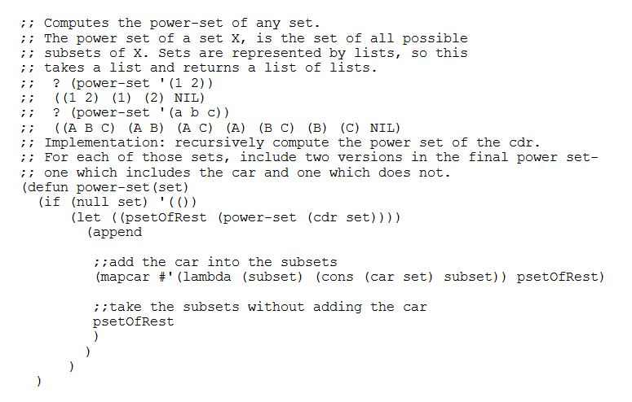
LISP
LISt Processing Wiki article
Designed by John McCarthy (Turing Award), appears about 1960
First “functional” PL

Slide 15
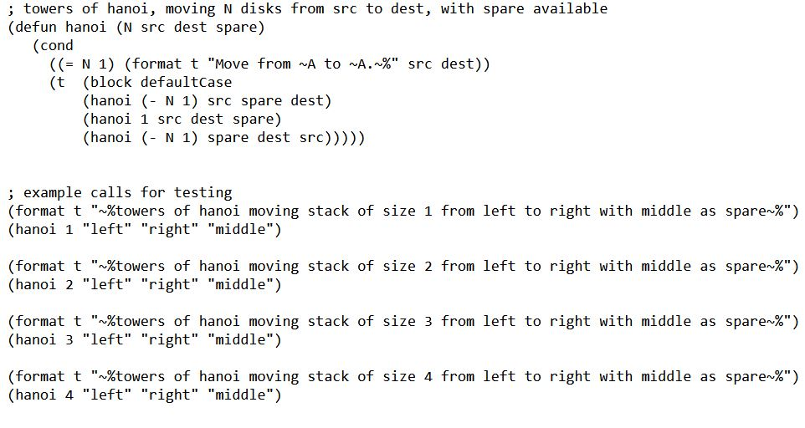
LISP

Slide 16
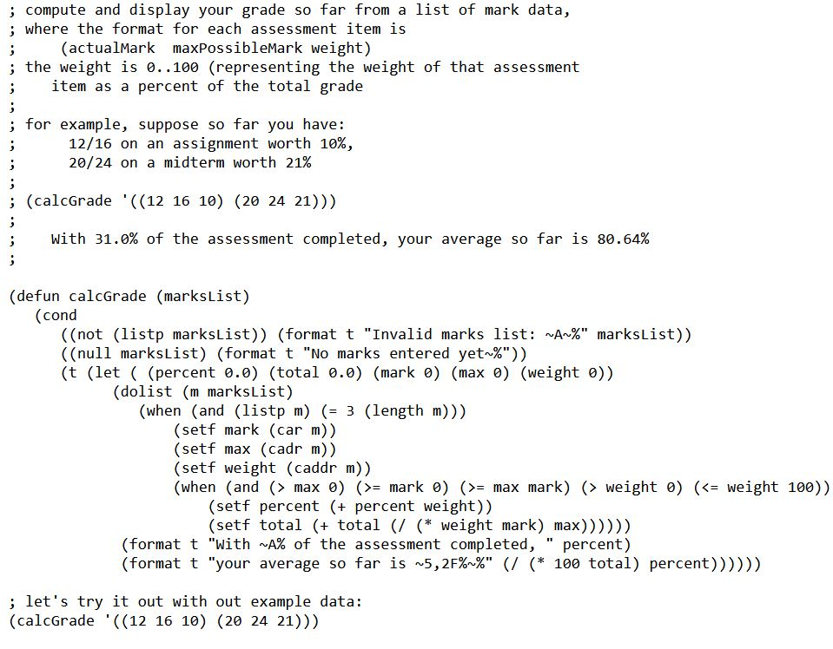
LISP

Slide 17
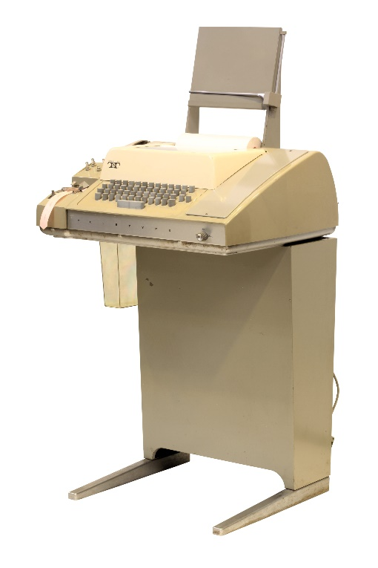
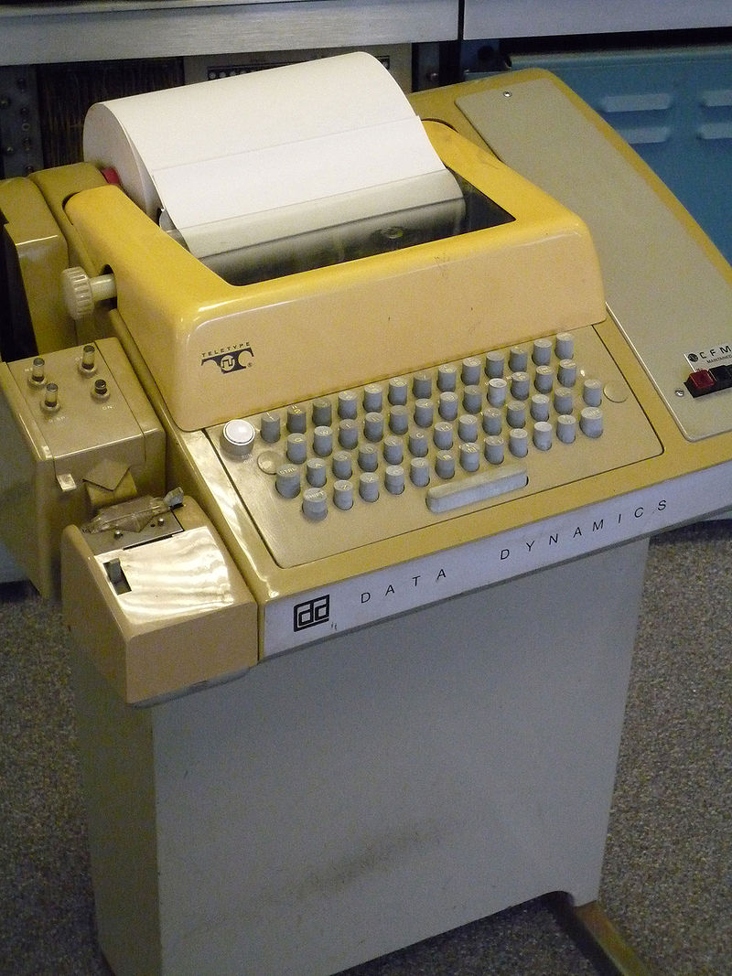
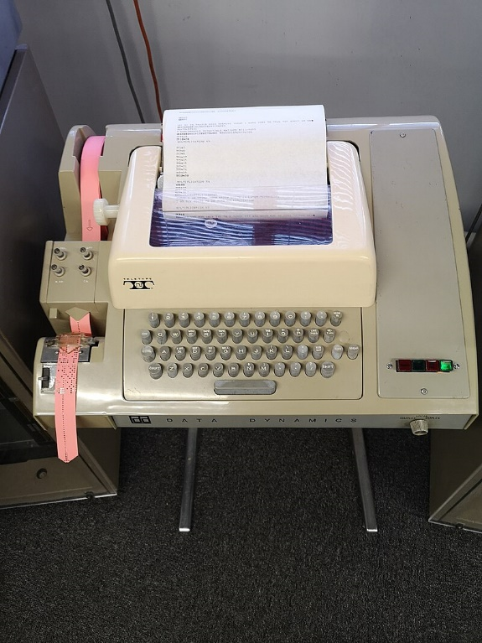
BASIC
Beginners' All-purpose Symbolic Instruction Code
Kemeny and Kurtz (Dartmouth), mid-1964
-- Innovative in interactive shell-ish user interaction
-- Time sharing machines
-- Not batch oriented like others PLs of the time
-- intended for teaching, programming literacy for non-STEM students

Slide 18
Sample Basic Programs
10 INPUT "What is your name: "; U$
20 PRINT "Hello "; U$
30 INPUT "How many stars do you want: "; N
40 S$ = ""
50 FOR I = 1 TO N
60 S$ = S$ + "*"
70 NEXT I
80 PRINT S$
90 INPUT "Do you want more stars? "; A$
100 IF LEN(A$) = 0 THEN GOTO 90
110 A$ = LEFT$(A$, 1)
120 IF A$ = "Y" OR A$ = "y" THEN GOTO 30
130 PRINT "Goodbye "; U$
140 END
10 LET N=10
20 FOR I=1 TO N
30 PRINT "Hello!"
40 NEXT I
50 END
10 PRINT “Hello!”
20 GOTO 10
Web-based BASIC interpreter:
https://www.calormen.com/jsbasic/

Slide 19
Sample APL Program (source)
Ken Iverson, 1962-ish (at IBM)
Example: Conway’s Game of Life
Alan Kay on APL
APL Has been called a “write-only language” ( and here )
And so you know…

Slide 20
Bit of Fun… just for fun
Timeline of Programming Languages

Slide 21
Spaghetti Code
GOTO allowed arbitrary flow of control
Loops manually constructed with semantics/behavior potentially specific to each separate loop
“Standard” loop behavior could be done with patterns but it was up to each programmer to do this correctly
100 x = 0; 110 y = 12; 200 x = x+1; 205 k = 27 * x; 210 y = y * x; 215 if y > 5000 goto 300 220 goto 200
300 z = 400 * y; 310 y = y % x; 320 if even(y) goto 200 // jumps to the loop increment
// but it doesnt have to... it might define some random // entry into the middle of the loop body // making the loop have multiple entry points 320 if prime(y) goto 205 // jumps into loop body, skips increment 400 etc..

Slide 22
Structured Coding
Response to convoluted goto programming
Convert assembly coders to a new way…
Controversial ! ( so what isn’t )
Goto Statement Considered Harmful
Dijkstra paper (CACM ‘68)
Structured coding (single-in, single-out, no goto)
c. 1960s, spaghetti still in high-level languages
structured flow control was beginning
but goto was still there too

Slide 23
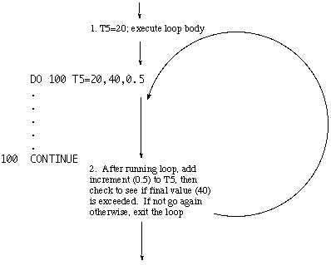
FORTRAN IV (early to mid 60’s)
DO loop is part of it… single in, single out
But GOTO is also part FORTRAN IV “backwards compatible”
FORTRAN I, II, III, IV, 66, 77, 90, 95, 2003, 2008, 2018, 2023
When was GOTO taken out of FORTRAN ?

Slide 24
Structured Coding
Structured Program Theorem
All computable functions can be computed with combinations of just 3 single-in single-out control flow structures
sequence
selection
repetition
This means GOTO is not needed
Dijkstra (and many others) noted that more than NOT NEEDED, it should be banished for code quality, fewer logic errors, etc.
This resisted by many assembly programmers, but now its gone from most high-level PLs

Slide 25
OO History
How did we get to Modern Objects?
Early objects and classes appear in Simula 67
Developed in Oslo by Dahl and Nygaard from 1962 on
Dahl and Nygaard win 2001 Turing Award
Generally SmallTalk-80 is considered the first widely used OO PL, and influenced many after it
Xerox PARC, Alan Kay, Adele Goldberg, Dan Ingalls, et al. from 1972 on
Alan Kay won the 2003 Turing Award
Labs using Smalltalk at Xerox led to GUIs, WYSIWIG, Agile methods, Design Patterns into the late 90’s

Slide 26
The Wirth Contribution
Niklaus Wirth (Turing award 1984)
Career at Stanford and ETH in Switzerland, researched several early PL issues related to scope, encapsulation, modules etc.
Largely based off ALGOL-60 which introduced lexical scope, named functions called recursively, nested functions
influenced PL/1, Simula, and C among many others (directly and by extension)
Languages Wirth produced
PL360 (1966 while at Stanford)
Algol-W (1966) (make things as simple as possible and no simpler)
Pascal (1970) (huge impact as a teaching PL, impact like Java had)
Modula (1975), Modula-2 (1977 to 1985) (early objects-ish)
Oberon (1987) (still being updated as recently as 2020)

Slide 27
Modern OO PLs
Some PLs designed for Objects
Simula, Smalltalk-80
Java, C++
Ruby, Python, Objective-C, C#
Javascript, Typescript
Some have Objects added in
PHP, Perl, R, Lisp, Fortran, Pascal, etc. ( FOMO ? )
First widely used OOPL … Java
Developed by James Gosling at Sun Microsystems
Started 1991, released Java 1.0 in 1996
Oracle bought Sun in 2009

Slide 28
Modern OO PLs
But… C++ ?
Developed by Bjarne Stroustrup at ATT Bell Labs
Started 1979 (C with Classes), 1982 C++, released Oct 1985
and… Smalltalk ?
Developed by Alan Kay (Dan Ingalls, Adele Goldberg) at Xerox PARC
Project started in 1969, lead to Smalltalk-71, -72, -76 (internal use)
Smalltalk-80 released publicly in 1981
“Smalltalk” usually means Smalltalk-80

Slide 29
Thought experiment …
Are Objects and OOP something new?
Do OO PLs give us new coding powers or capabilities?
Can we program objects in, say, original Fortran ?

Slide 30
Use of PLs over the decades
Here are a couple of fun vids showing how use of Programming Languages evolved over time
PLs in use, 1965 to 2019
PLs used in github code, 2012-2019

Slide 31
OO Principles
Four “Pillars” tell why we do OO
encapsulation
abstraction
inheritance
polymorphism
-- this is not simply generics
-- might be done with templates
object
class

Slide 32
OO Principles
Polymorphism
To exhibit polymorphism, a function f( ) must be able to operate on arguments of different types and do appropriate things for each
Type1 x;
Type2 y;
f(x); f(y);
Might be done with overloading
void f ( int x ) { x += 2 ; }
void f ( double x ) { x += 2.0; }
f(5); f(6.3); // types distinguish which “f” is being called

Slide 33
OO Principles
Polymorphism
Might be done with inheritance
class TopType { }
class Type1 inherits from TopType { }
class Type2 inherits from TopType { }
Type1 v1; Type2 v1;
function funcy (TopType v) {
// do something to v
}
funcy(v1); // is ok
funcy(v2); // is ok

Slide 34
OO principles
Dynamic dispatch (for polymorphism)
Often called dynamic polymorphism
Object decides (at runtime) what procedure code to execute in response to a message/call to a method
Can be done with a lookup table where the mappings change as execution proceeds
Java is static, objects have compile-time fixed properties
Used in dynamically typed languages like Python

Slide 35
OO Principles
Dynamic dispatch (for polymorphism)
In Java, can get close with subtyping
class Game {
public void type ( ) { System.out.println( “Indoor-Outdoor” ); }
}
class Cricket extends Game {
public void type ( ) { System.out.println( “Outdoor” ); }
public static void main (String[] args) {
Game gm = new Game();
Cricket ck = new Cricket();
gm.type();
ck.type();
gm = ck; // now gm points to Cricket object
gm.type(); // different behavior than before
}
}

Slide 36
OO Has Its Critics
Including some serious objections
See the Wikipedia OOP article
“ There are only two kinds of languages: the ones
people complain about and the ones nobody uses. ”
― Bjarne Stroustrup, The C++ Programming Language

Slide 37
Assignment 0
Due ASAP but by Sunday at 9:00 pm, in email to class account
One email per team
Make teams (of 1, 2, or 3), then send me an email telling me the names of those who will be working together
One email per team with all names in that email (to class acct)
Those wishing to be a team of 1 send me an email saying “solo” (so I can tell when all are in the class are accounted for)
If you wish to be on a team, but have no name(s) to join, please as well send me an email with your name saying you wish to be added to a team… I will pair you or triple you as I can

Slide 38
Assignment 1 ( solo, not team )
Due next Wednesday (9:00pm), upload to Canvas as PDF
One paper per person ( not team work )
Research OO methods, languages, and concepts and find objections to it as a programming technology…
What are its failings and shortcomings?
We are looking for a list to keep in mind -- as language designers -- to guide the development of new languages, methods, and tools to alleviate and manage these problems as we push software development technology ahead
Feel free to add your own thoughts about OO problems…
-- But have references for ideas and comments you find from others

Slide 39
END

