Slide 1
On Beyond Objects Programming in the 21th century COMP 590-059 Fall 2024
David Stotts
Computer Science Dept
UNC Chapel Hill

Slide 2
Erlang Processes and Concurrency

Slide 3
Concurrency: Processes
Spawn a simple process
Erlang was designed for massive concurrency
A process is created and terminated very rapidly, so you can easily have thousands of them
A process executes some piece of code, then it terminates.
It can also run forever.
Each Erlang process has a small memory footprint, which can grow/shrink dynamically
Use the built-in `spawn` function to create a process.
Once created, a process can access its own process id, by calling the `self` function.
-module(procs).
-compile([export_all]).
proc() -> io:format("I'm a process with id ~p~n", [self()]).
procInf() -> io:format("I'm a process with id ~p~n", [self()]),
loop().
loop() -> loop().
run() ->
spawn(fun() -> proc() end), % ends
spawn(procs, proc, []), % ends
spawn(?MODULE, proc, []), % ends
spawn(?MODULE, procInf, []), % runs “forever”
okay.

Slide 4
In the Shell…
11> c(procs).
{ok,procs}
12> self().
<0.79.0> % PID of the shell process
13> procs:proc()
I’m a process with id <0.79.0> % again, the shell process
% note this is a func call, not a spawn
% so we see the shell process run the func
14> procs:run().
I’m a process with id <0.163.0> % new spawned process, not the shell
I’m a process with id <0.164.0> % another process
I’m a process with id <0.165.0> % yet another process
I’m a process with id <0.166.0> % 4th process, made from a different func
15> Ipa = fun(PID) -> erlang:is_process_alive(PID) end.
16> Ipa(<0.165.0>).
false % 3rd spawned process has ended (it just prints one line)
17> Ipa(<0.166.0>).
true % 4th spawned process is still running (in an inf loop)

Slide 5
First look at the Actor model
Carl Hewitt’s Actor Model of Concurrency

Slide 6
Processes: You’ve Got Mail
Message Handling
Every process has a mailbox
Mailbox is a queue of messages… when a process receives a new message it is enqueued (at the back)
The receive block will try each message in the queue (from front, oldest first) against the patterns in the receive block (in order), until one of the messages matches (or all are checked )
When a match happens, the message is removed from the mailbox queue, and the logic corresponding to the matched pattern will get executed.

Slide 7
Concurrency: Processes
make_request(ServerId, Msg) ->
ServerId ! Msg.
run() ->
Pid = spawn(?MODULE, serve, []),
make_request(Pid, request1),
make_request(Pid, request2),
timer:sleep(10),
Pid2 = spawn(?MODULE, math, []),
Pid2 ! {add, 1, 2},
Pid2 ! {sub, 3, 2},
okay.
Process communication
Processes in Erlang share no memory, hence they communicate via message passing.
Each process has a mailbox.
The `receive` block allows a process to do something with the messages in its mailbox.
A process can receive different kinds of messages, then act on them.
To send a message to a process, use the `!` operator, after the process id of the receiver process
-module(send_recv).
-compile([export_all]).
serve() -> receive
Request ->
io:format("Handling: ~s~n", [Request]),
serve()
end.
math() -> receive
{add, X, Y} ->
io:format("~p + ~p = ~p~n", [X,Y,X+Y]),
math();
{sub, X, Y} ->
io:format("~p - ~p = ~p~n", [X,Y,X-Y]),
math()
end.

Slide 8
Processes: Mailbox
oldest
Message Handling
math() -> receive
{add, X, Y} ->
io:format("~p + ~p = ~p~n", [X,Y,X+Y]),
math();
{sub, X, Y} ->
io:format("~p - ~p = ~p~n", [X,Y,X-Y]),
math()
end.
sub, 13, 5
add, 4, 7
mult, 9, 17
If no match is found, then that message stays in the mailbox, and the next message is tried for a match against the receive block’s patterns.
newest
If no message in the box matches any receive block pattern, the process will get suspended until a new message arrives
When a new message arrives (and is put at the back of the queue), the process wakes, and the message processing logic starts all over, beginning with the first message in the mailbox (front of the queue).

Slide 9
Receive: Order of Steps
math() -> receive
{add, X, Y} ->
io:format("~p + ~p = ~p~n", [X,Y,X+Y]),
math();
{sub, X, Y} ->
io:format("~p - ~p = ~p~n", [X,Y,X-Y]),
math()
end.
When a message is sent it is queued FIFO in the mailbox.
When a process comes to a “receive” block it goes to the mailbox queue and considers the first message there (the oldest message, the one that arrived first).
It tried to match that message against the patterns in the receive block clauses is the order written, top down ( here, {add … } first, then {sub … } ).
The first pattern that matches, the process executed the block with that clause… then the receive block ends and execution passes to what follows.
If no clause pattern matches, then the procedure is repeated with the next message in the queue
If no message in the queue matches any clause pattern the process blocks and waits for the arrival of the next message

Slide 10
A process is created and terminated extremelly fast, that's why you can actually have thousands of them.
Processes: Linking
Links are Bi-directional
Two processes can be linked to each other
To link a process to the current one, spawn it, then use the `link` function to create a link.
You can spawn and link a process atomically using the ‘spawn_link‘ function.
-module(links).
-compile([export_all]).
child() ->
io:format("I(child) have pid: ~p~n", [self()]),
receive
after 2000 ->
io:format("I(child ~p) will die now!~n", [self()])
end.

Slide 11
Processes: Linking
When a process terminates, it will terminate with an exit reason.
This exit reason is emitted in an exit signal to all linked processes.
The default behavior when a process receives an exit signal with an exit reason (other than `normal`), is to terminate
The terminating process will in turn emit exit signals with the same exit reason to its linked processes.
An exit signal with reason `normal` is ignored.
A process can be set to trap exit signals by setting the `trap_exit` process flag to `true`.

Slide 12
A process is created and terminated extremelly fast, that's why you can actually have thousands of them.
Example: Process Linking
Links are Bi-directional
Two processes can be linked to each other
To link a process to the current one, spawn it, then use the `link` function to create a link.
You can spawn and link a process atomically using the ‘spawn_link‘ function.
-module(links).
-compile([export_all]).
child() ->
io:format("I(child) have pid: ~p~n", [self()]),
receive
after 2000 ->
io:format("I(child ~p) will die now!~n", [self()])
end.

Slide 13
Example Process: Linking
parent() ->
Pid = spawn(links, child, []),
link(Pid),
io:format("I (parent) have pid ~p~n", [self()]),
io:format("I (parent) have a linked child: ~p~n", [Pid]),
lists:foreach(
fun(_) -> P = spawn_link(links, child, []),
io:format("I(parent) have another linked child: ~p~n", [P])
end,
lists:seq(1,4)
),
process_flag(trap_exit, true),
receive
{'EXIT', Pid, Reason} -> timer:sleep(10),
io:format("I(parent) have dying child(~p). Reason: ~p~n", [Pid,Reason]),
io:format("I(parent) will die too ...~n")
end.

Slide 14
Example Process: Linking
grandparent() ->
Pid = spawn_link(links, parent, []),
io:format("I (grandparent) have pid ~p~n", [self()]),
io:format("I (grandparent) have a linked child: ~p~n", [Pid]),
process_flag(trap_exit, true),
receive
{'EXIT', Pid, Reason} ->
timer:sleep(10),
io:format("I(gparent) have dead child(~p). Reason:~p~n", Pid,Reason]),
io:format("I(gparent) will die too ...~n")
end.
run() ->
spawn(links, grandparent, []),
timer:sleep(1500),
ok.

Slide 15
Linking Idioms
3 Basic Linking Idioms with Erlang processes
I don't care if my child process dies:
spawn(...)
I want to crash if my child process crashes:
spawn_link(...)
I want to receive a message if my child process terminates (normally or not):
process_flag(trap_exit, true),
spawn_link(...)

Slide 16
Processes: Monitoring
Monitors are alternative to Links
Monitors are unidirectional
This worker will wait for ?TIMEOUT ms, and if it does not receive any work it will die
a `{'DOWN', Ref, process, PidOfTerminatedProc, Reason}` message will be send to its monitors.
-module(monitors).
-compile([export_all]).
-define (TIMEOUT, 3000).
worker() ->
receive
do_work ->
io:format("I (worker ~p) will work now~n", [self()]),
worker()
after ?TIMEOUT ->
io:format("I (worker ~p) have no work to do~n", [self()]),
io:format("I (worker ~p) will die now ...~n", [self()]),
exit(no_activity)
end.

Slide 17
Example Code: Monitoring
To monitor a process, use the function `erlang:monitor` then listen for `DOWN` messages in the `receive` block.
Repeated calls to `erlang:monitor` will create several, independent monitors.
register/2 is a BIF to associate a name (an atom) with a PID… making sort of an alias
A process is automatically un-registered when it terminates
parent() ->
Pid = spawn(monitors, worker, []),
register(worker, Pid),
Ref = erlang:monitor(process, Pid),
io:format("I (parent) have a new worker~p~n", [Pid]),
?MODULE ! {new_worker, Pid},
receive
{'DOWN', Ref, process, Pid, Reason} ->
io:format("I(parent) My worker ~p died (~p)~n",[Pid,Reason]),
parent()
end.

Slide 18
Example Code: Monitoring
loop() -> receive
{new_worker, WorkerPid} -> timer:sleep(?TIMEOUT-2000),
WorkerPid ! do_work,
loop()
end.
start() -> Pid = spawn(monitors, loop, []),
register(?MODULE, Pid),
ParentPid = spawn(monitors, parent, []),
register(parent, ParentPid),
Ref = erlang:monitor(process, Pid),
erlang:demonitor(Ref), % removes the monitor from process Ref
timer:sleep(round(?TIMEOUT*1.5)),
exit(whereis(worker), finished),
exit(whereis(parent), finished),
exit(whereis(?MODULE), finished),
ok.

Slide 19
Processes: The Shell
Process handling in Erlang shell
The shell gives you abilities to see and manage the processes running in the ERTS
processes( ). will list the PIDs of all processes in the system… but careful, some industrial apps can have a million processes
i( ). will give a readable table of what each process is doing
The shell is a process like the ones we spawn
Means we can send messages to the shell
flush( ). Will clear out a mailbox
4> PD = self().
<0.79.0>
5> PD.
<0.79.0>
6>
6>
6> PD ! go_heels.
go_heels
7> PD!win_game, PD!coding_rules, PD!lastOne.
lastOne
9> flush().
Shell got go_heels
Shell got win_game
Shell got lastOne
ok
10> flush().
ok
11>

Slide 20
Processes: Shell as a Process
Message Send always succeeds
Even if the receiving process is terminated
If send a message to a non-existent process, it is discarded without causing an error
Message sender is not suspended after sending, it just executes on to its next clause
Since the shell is a process, you can send it messages… we saw this…
Now lets test the message to dead process behavior using the shell
12> PD = self().
<0.79.0>
13> 1/0.
** exception error: an error occurred when evaluating an arithmetic expression
in operator '/'/2
called as 1 / 0
14> self().
<0.95.0>
15> pid(0,79,0) ! hello.
hello
16> flush().
ok

Slide 21
Processes: Hot Swapping Code
Process can have new code subbed in while executing
Simple compared to other languages/systems
-module(hot).
-compile([export_all]).
go() ->
Pid = spawn(hot,server,[]),
register(hs,Pid).
% hot swap version… runs newest beam file for the code
server() -> receive
Msg ->
io:fwrite("Msg: ~s~n", [Msg]),
hot:server() % module_name : function
end.
% static version… runs the beam version that existed when first executed
cerver() -> receive
Msg ->
io:fwrite("Msg: ~s~n", [Msg]),
cerver() % no module name
end.

Slide 22
Processes: Synchronization
Locks, Semaphores, etc. ?
Much of the difficulty in Java threads coding comes in managing locks, semaphores, synchronized blocks, atomic data structures, etc. so as to prevent race conditions and deadlocks
Erlang has far fewer difficulties like this due to the synchronization of processing being done in the mailbox mechanism (the actor model).
The Actor model is also non-shared memory, so there is no shared data on which processes may create race conditions
There are no manual locks, etc. but rather the semantics of how messages are sent, and how they are received, create the necessary synchronization among concurrent processes

Slide 23
Mechanisms: Send
Locks, Semaphores, etc. ?
Message sending is asynchronous, and non-blocking
Asynchronous means one process may send without requiring the other process being ready to receive. Email is asynchronous; a telephone call is synchronous
Non blocking means the sender does not wait, or get put on a queue asleep to complete any send
A send operation always succeeds

Slide 24
Mechanisms: Send
Locks, Semaphores, etc. ?
A send operation always succeeds and does not block
If the receiving process is alive, the sent message is guaranteed to be put in the receiving mailbox
Mailboxes are unbounded abstractly ( practical system limitation may make this unrealizable )
This means there is no notion of “mailbox full, msg not sent”, or “mailbox full so you sit and wait until there is room for the send”
Even if a process tries to send a message to another process that does not exist, the send appears successful to the sender

Slide 25
Mechanisms: Receive
Message receiving can be blocking
The receiving process decides if, when, and how to accept messages ( how to process messages… when sent a message is always put into the mailbox of the receiver )
Default behavior on receiving a message is to enter a receive block and look for the first message that matches one or a collection of patterns.
If no match is found, the receiving process sleeps until another message arrives
So receiving can block a process until some circumstances it wants happen

Slide 26
Mechanisms: Selective Receive
Message receiving is selective
receive
{msg_type, Data} ->
%% Handle message
...
after 1000 ->
%% Timeout case
...
end.
In this way, a process can prevent itself from being blocked indefinitely waiting on some message arrival that may never happen
Messages sent from one process to another are guaranteed to arrive in the order they were sent, which helps in synchronization between sender and receiver. However, this guarantee only applies between the same sender and receiver pair, not across different senders.

Slide 27
Mechanisms: Ordering
Messages sent from one process to another are guaranteed to arrive in the order they were sent, which helps in synchronization between sender and receiver.
This guarantee only applies between the same sender and receiver pair, not across different senders.
Consider different senders sending to one receiver (S1, S2, R)
S1 sends M1 and then M2 to R … R will see M1 in the mailbox queue before M2, always (in any execution)
This means time progress/causality holds in the execution of S1 (and every process)
However, is S1 sends MMa to R, and S2 sends MMb to R, we cannot know which of MMa/MMb will be first in the mailbox of R

Slide 28
Deadlock
We said race conditions don’t generally happen because no data is explicitly shared among processes
Erlang process also do not deadlock is a traditional sense, or rather not nearly as often as in a shared memory model
Asynch message passing, and no shared memory in the Actor model leads to this
However, we can still design processes that inherently will lead to deadlock
We might say Erlang processes much less often accidentally deadlock, but we are still free to “deliberately” program them to deadlock with bad algorithm design

Slide 29
Deadlock: Example
Deadlocks can still happen from improper handling of message passing, circular waits, or unhandled message cases
% circular wait
%% Process A
receive
{msg_from_b, Data} ->
%% Waiting for message from B
io:format("Received from B: ~p~n", [Data])
end.
%% Process B
receive
{msg_from_a, Data} ->
%% Waiting for message from A
io:format("Received from A: ~p~n", [Data])
end.
If one or both fail to execute a send, then they both sit and wait

Slide 30
Deadlock: Example
Previous example has indefinite waiting… no timeouts
Timeout can provide partial solutions
receive
{ok, Data} ->
%% Handle message
after 5000 ->
%% Handle timeout after 5 seconds
io:format("Timeout waiting for message~n")
end.

Slide 31
Deadlock: Design Tips ( chatGPT )
Avoid Circular Dependencies: Design your process communication such that processes don’t end up waiting on each other
Use Timeouts: Always specify timeouts in your receive blocks so that processes can detect when a message is not arriving as expected and take corrective action (e.g., retrying, error log, or handling timeout).
Clear Protocols for Message Passing: Ensure that processes follow clear, well-defined protocols for message exchange. If a process expects a reply, the sending and receiving logic should be consistent, and use message ack mechanisms.
Detection: Erlang’s philosophy relies on supervisors to monitor processes. If a process becomes unresponsive (e.g., due to being stuck in a receive block waiting for a message), the supervisor can terminate and restart the process, effectively breaking any deadlock-like situation.

Slide 32
Processes: Miscellaneous
Collection of Facts About Erlang and Processes
OTP is a collection of libraries and design principles that comes with the Erlang language distribution and makes building larger systems easier
OTP is a bit like Java collections, but the abstrations it supports tend to be towards processes and concurrency… like a generic server
Erlang debugger (in OTP) can be used from the shell with debugger:start( ).
Debugger documentation here: https://erlang.org/doc/apps/debugger/debugger_chapter.html
wxErlang is an Erlang binding for the wxWidgets package (written in C++) for making GUIs for Erlang programs

Slide 33
Processes: Miscellaneous
Collection of Facts About Erlang and Processes
ERTS (Erlang Run Time System) is the virtual machine and run time system that makes Erlang able to support thousands of processes efficiently
ERTS is like Java JRT, BEAM (VM) is like JVM
ERTS does its own process threads, does not use the OS to create threads (for speed)
Each process has its own stack and garbage collection… so not large pauses in the VM for garbage collection… it is done continually in small pieces as processes execute
Once spawned, a process will continue and remain alive until termination
Normal termination occurs when a process has no more code to execute
An explicit terminate action, or some error, causes termination with non-normal reason, which can be signaled to related processes
spawn/3 never fails, even if func does not exist… PID is returned and the new process terminates with a runtime error

Slide 34
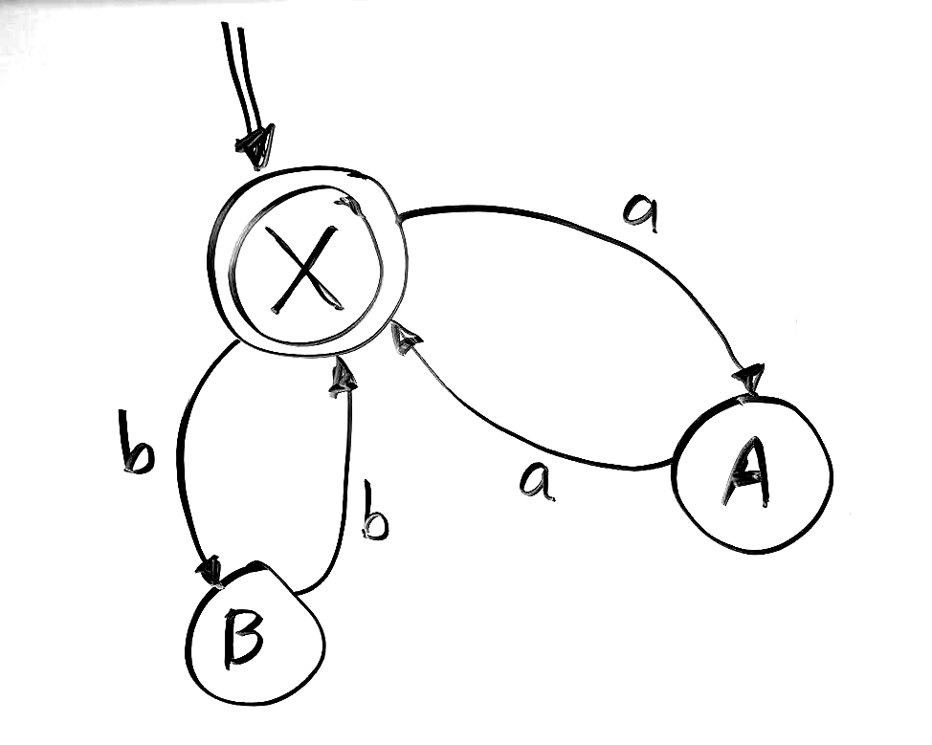
Processes: FSM example
Let’s make an FSM simulation
First try will be make each state a separate process
We will have input be a list of atoms, something like this: [a,b,c,b,c,b,a,a]
Valid inputs:
[a,a,b,b]
[ ]
[a,a]
[b,b,a,a,b,b,b,b]
etc.
Invalid inputs:
[a,b]
[a]
[a,b,b,a]
[a,b,a,b,a,b]
etc.
Consider this FSM

Slide 35
FSM (one way)
-module(fsm1).
-compile([export_all]).
go() ->
{ok, W} = io:read("type input as atoms in a list: "),
io:fwrite("Input word: ~p ~n",[W]),
% start up the state processes
register(sa, spawn(?MODULE,stateA,[])),
register(sb, spawn(?MODULE,stateB,[])),
register(sx, spawn(?MODULE,stateX,[])),
Start = sx, % start state is X
Final = sx, % accepting state is X
Curr = sx, % current state
fire(Start,W).
clean() -> unregister(sa) ,unregister(sb) ,unregister(sx) .
fire(_, []) -> clean(), accept;
fire(CS,[H|RestOfInput]) ->
%io:fwrite("char: ~p ~n",[H]),
CS ! {self(),H},
timer:sleep(1000),
receive
{NextState} -> fire(NextState,RestOfInput); % keep going
M -> io:fwrite("Error: Bad Input ~p~n",[M]) % halt
end.

Slide 36
A process is created and terminated extremelly fast, that's why you can actually have thousands of them.
FSM (one way)
stateX() ->
receive
{Pid, a} ->
io:fwrite("in X, ~p~n",[a]),
Pid ! {sa},
stateX();
{Pid, b} ->
io:fwrite("in X, ~p~n",[b]),
Pid ! {sb},
stateX();
M ->
io:fwrite("in X, ~p~n",[M]),
exit(BadInput)
end.
stateA() ->
receive
{Pid, a} ->
io:fwrite("in A, ~p~n",[a]),
Pid ! {sx},
stateA();
M ->
%exit(BadInput)
io:fwrite("in A, ~p~n",[M]),
stateA()
end.
stateB() ->
receive
{Pid, b} ->
io:fwrite("in B, ~p~n",[b]),
Pid ! {sx},
stateB();
M ->
%exit(BadInput)
io:fwrite("in B, ~p~n",[M]),
stateB()
end.

Slide 37
FSM (another way)
-module(fsm2).
-compile([export_all]).
stateX() ->
receive
[] ->
io:fwrite("in X, end of input, so accept~n"),
clean(), accept;
[a|Rest] ->
io:fwrite("in X, ~p~n",[a]),
timer:sleep(1000),
sa! Rest,
stateX();
[b|Rest] ->
io:fwrite("in X, ~p~n",[b]),
timer:sleep(1000),
sb ! Rest,
stateX();
M ->
io:fwrite("in X, ~p, fail~n",[M]),
clean(),
exit(self(),bad_input)
end.
go() ->
{ok, W} = io:read("type input list: "),
register(sa, spawn(?MODULE,stateA,[])),
register(sb, spawn(?MODULE,stateB,[])),
register(sx, spawn(?MODULE,stateX,[])),
Start = sx, % start state is X
Final = sx, % accepting state is X
sx!W. % send the input to start state

Slide 38
A process is created and terminated extremelly fast, that's why you can actually have thousands of them.
A process executes some piece of code, then it terminates. It can also run forever.
FSM (another way)
stateA() ->
receive
[a|Rest] ->
io:fwrite("in A, ~p~n",[a]),
timer:sleep(1000),
sx ! Rest,
stateA();
M ->
io:fwrite("in A, ~p, fail~n",[M]),
clean(),
exit(self(),bad_input)
end.
stateB() ->
receive
[b|Rest] ->
io:fwrite("in B, ~p~n",[b]),
timer:sleep(1000),
sx ! Rest,
stateB();
M ->
io:fwrite("in B, ~p, fail~n",[M]),
clean(),
exit(self(),bad_input)
end.
clean() ->
unregister(sa),
unregister(sb),
unregister(sx) .

Slide 39
END

