Slide 1
On Beyond Objects Programming in the 21th century COMP 590-059 Fall 2024
David Stotts
Computer Science Dept
UNC Chapel Hill

Slide 2
The Go Language ( golang )

Slide 3
History (reference)
Go Lang
Go is designed at Google by Robert Griesemer, Rob Pike, Ken Thompson (Unix and B fame)
Started in 2007, first appears for use in Nov. 2009
Version 1.0 released March 2012
Intended for an era of multicore hardware (concurrency), networked platforms, large codebases for new projects
Wanted to keep static typing, run-time efficiency (like C)
Wanted readability and usability (like Python)
High-performance on networks and multiprocessors
Developers did have a dislike of C++ in common

Slide 4
History
Go Lang
Developers did have a dislike of C++ in common ( Ken Thompson, YouTube )
Ken Thompson interview
The Go Team interviewed
Rob Pike’s 5 Rules of Programming
Rob Pike: Why Go is Successful?
Rob Pike on Parallelism

Slide 5
History
Go Lang
New style of “OO” programming
From the 2010 Bossie Award citation (14 years ago):
Google’s Go language tries to restore simplicity to programming.
It does away with numerous constructs that have crept into all OO languages by re-imagining how to simplify and improve the conversation between a developer and the code.
Go provides garbage collection, type safety, memory safety, and built-in support for concurrency and for Unicode characters.
In addition, it compiles (fast!) to binaries for multiple platforms.
Go is still in development (new features are being added) and it has limitations, notably poor support for Windows.
But it shows a new, exciting direction in programming languages.

Slide 6
Go Features
Go Lang
The language has …
Statically typed, multiple paradigm, compiled, general purpose
Syntax is C-ish
Concurrent programming made for multi-core, uses “go-routines” and channels
Deferred garbage collection, does not pause program execution
Not VM based, so faster than Java
Type inference
Unique error handling, using explicit return values
Not OO, no inheritance or reflection
Supports unit-testing
Compiled separately to binaries for each platform you wish to run on ( more tranditionaly, not compile-once-run-anywhere like Java )
Built-in package management, using “go modules”

Slide 7
Basic Go Components
Go Lang
basic data int, float, complex, boolean, string, byte, rune (32-bit Unicode)
data structures struct, array, slice, map
scope global, or function-level
export visibility outside files defining names
types programmer defined
pointers ( but no pointer arithmetic )
function can return multiple results
method a function attached to a struct (no objects)
goroutine concurrency and synchronization, using channels
functions as values closures interface
goto, and label on statements

Slide 8
First Go Program
Go Lang
package main
import "fmt“
func main() {
fmt.Print("Hello ")
x := sub_sq(15)
fmt.Println(x)
}
func sub_sq ( x int) int {
return x*x
}
Lets try this example in the Windows shell
Put the code anywhere (for now). Lets make a file on my desktop

Slide 9
Online Go execution
Go Lang
https://play.go-lang.org/
Easy small Go program editing and execution
Alternative to installing on your laptop/host
Good for debugging small experiments

Slide 10
Packages
Go Lang
Packages are grouping units for code, helps to organize your project
In Go every program is organized into one (or more) packages
A package groups one (or more) source files
The main package is special in Go, signifying that the package is executable
The main package must contain a main() function. This function is the entry point of the program. When you run the program, Go looks for the main package and executes the main() function.
So every executable Go program is a main package alone, or perhaps the main package with other packages

Slide 11
Packages
Go Lang
To use code in a package, you import the package
Any code written in Go belongs to some package
A package is like a name space…
Code in a package can use all functions and data defined in that package
A package specifies what functions and data are exported
Only exported names (function, variable) are visible to code outside the package
Upper case first char is exported ( public and visible in all packages )
lower case first char is not exported ( private to the package )
By convention, package names are all lowercase, no space or “_”
Go Standard Library is a package, can be viewed here , compact for now

Slide 12
Package Example
Go Lang
Physically, a package is just a directory.
Directory name and the package name should be the same … a convention
Go tools and programmers use this convention, so good idea to follow it
Functions, types, variables, and constants defined in one source file are visible to all other source files within the same package
example…
Executable program has one “main” package
That main package must have a main function
Function main is the first to execute
Package in general, however, need not have a main function
package main
import "fmt"
func main() {
fmt.Print("Hello ")
x := sub_sq(15)
fmt.Println(x)
}
func sub_sq (x int) int { return x*x }

Slide 13
Package Conventions
Go Lang
We have already mentioned the convention that package names are all lowercase with no spaces or underscores
Source file names by convention are all lowercase as well
Source file names end in the .go extension
A package can comprise multiple source files, and all are by convention located in one directory / folder
Similarly, all source files in a folder are by convention in one package
Package is all in one directory, each directory is a separate package
-- These conventions are followed to limit confusion in code organization
-- They can be broken, but doing so should require a good reason
-- Following them makes your code readable by other Go programmers

Slide 14
Global, Local Scopes
Go Lang
Local scope is anything declared inside a function definition
Global scope is anything outside all functions
package main
import "fmt"
/* global variable declaration */
var g int
func main() {
/* local variable declaration */
var a, b int
/* actual initialization */
a = 10
b = 20
g = a + b
fmt.Printf("value of a: %d, b: %d and g: %d\n", a,b,g)
}

Slide 15
Global, Local Scopes
Go Lang
package main
import "fmt"
/* global variable declaration */
var g int
func main() {
/* local variable declaration */
var a, b int
/* actual initialization */
a = 10
b = 20
g = a + b
fmt.Printf("value of a: %d, b: %d and g: %d\n", a,b,g)
bump(3)
fmt.Printf("value of a: %d, b: %d and g: %d\n", a,b,g)
}
func bump(n int) {
g = g * n // note, no explicit return
a := 5 // note := rather than =
b := a + g
}
New version
Added another function to use the global var “g”
New version
Local “a” and “b” created

Slide 16
Global, Local Scopes
Go Lang
package main
import "fmt"
/* global variable declaration */
var g int
func main() {
/* local variable declaration */
var a, b int
/* actual initialization */
a = 10
b = 20
g = a + b
fmt.Printf("value of a: %d, b: %d and g: %d\n", a,b,g)
bump(3)
fmt.Printf("value of a: %d, b: %d and g: %d\n", a,b,g)
}
func bump(n int) {
g = g * n // note, no explicit return
a := 5 // note := rather than =
b := a + g
}
:=
New version
Added another function to use the global var “g”
=
New version
Local “a” and “b” created

Slide 17
Block Scope
Go Lang
package main
import "fmt"
func main() {
x := 10
if true {
y := 20 // Only exists within this if block
fmt.Println("Inside if block:", x, y)
}
// fmt.Println(y) // this will cause a compile error: "undefined: y"
for i := 0; i < 2; i++ {
z := i * 10 // `z` is limited to this for loop block
fmt.Println("Inside for loop:", z)
}
// fmt.Println(z) // this will cause a compile error: "undefined: z"
}

Slide 18
Type System
Go Lang
Go has static typing of all data
Types checked at compile-time
Has type inference to make declaration simpler
Has interfaces that introduce flexibility
The simple yet powerful type system allows for
-- type safety
-- efficient memory usage
-- clear code
-- avoiding some complexities of other statically-typed PLs

Slide 19
Type System Summary
Go Lang

Slide 20
Type System Summary
Go Lang
and so no multiple inheritance

Slide 21
Type Inference
Go Lang
package main
import "fmt“
func main() {
fmt.Print("Hello ")
x := sub_sq( 15 )
fmt.Println(x)
}
func sub_sq ( n int) int {
return n*n
}
this line declares, AND initializes
What is the type of x ?
Go is strongly typed
Type is inferred from context, but it is one type chosen
Here, x in main is given type int

Slide 22
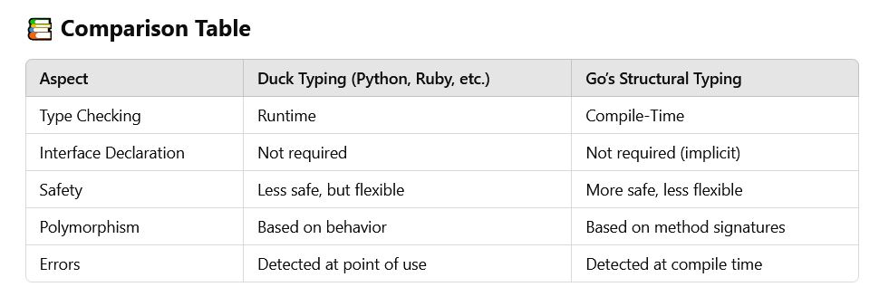
Duck Typing vs. Static
Go Lang

Slide 23
Type Inference
Go Lang
Weaker than type inference in other languages, like SML/NJ
In SML/NJ the type inference engine is used to create code that is as polymorphic as possible
It creates code the will allow it to be run on any many different types as possible
It only disallows a type is the ops in the code make no sense for that type
$ sml
-- fun max (x, y) = if x > y then x else y ;
val max = fn : ''a * ''a -> ''a
-- max (3, 5);
val it = 5 : int
-- max (3.5, 2.5);
val it = 3.5 : real
-- max ("apple", "orange");
val it = "orange" : string
As you write code, SML narrows down the applicable types until the function is completed, then reports the final type signature

Slide 24
Type Inference
Go Lang
Weaker than type inference in other languages, like SML/NJ
Here’s an SML example that ends up allowing full, unqualified polymorphism
$ sml
-- fun ident x = x ;
val ident = fn : 'a -> 'a
-- ident 42;
val it = 42 : int
-- ident "hello";
val it = "hello" : string
-- ident [1, 2, 3];
val it = [1, 2, 3] : int list
Type var ‘a means any unqualified type can sub in
‘ ‘ a means any type that can be compared with =

Slide 25
Goroutines: Simple Example
Go Lang
Concurrent threads/tasks/processes in Go
package main
import (
"fmt"
"time"
)
func hello(n int) {
if n>0 {
fmt.Printf("Hello world goroutine %p \n“, n)
go hello(n-1) // fires off a goroutine, concurrent
}
}
func main() {
go hello(5)
//time.Sleep(1 * time.Second)
time.Sleep(3100)
fmt.Println("main function")
}

Slide 26
Arrays and Slices
Go Lang
Summary comparison
Arrays
Fixed size defined at declaration, length is immutable
Value type so when you assign array A to another array B, a complete copy of A is made
Memory layout elements of an array are contiguous in memory
Uses less common, when need efficiency and don’t need dynamic length
Declaration var arX [10]string // 10 is the fixed length

Slide 27
Arrays and Slices
Go Lang
Summary comparison
Slices
Dynamic size wrapper on an array, grow and shrink as used
Reference type so if we assign slice A to slice B, both point to same underlying array… so changes to A can affect data in B
Memory layout 3 components to a slice… a pointer to array, slice length, and its capacity defining how far is can grow
Uses used more often than arrays, when dynamic growth is needed, when efficiency is not critical
Declaration
slx := []int{20, 11, 37} // literal
// or
slx := make([]byte, 0, 8) // slice with length 0 and capacity 8

Slide 28
Arrays and Slices
Go Lang
Arrays have a fixed size that is part of their type, meaning their length cannot change after declaration. They are value types, so when assigned to a new variable or passed to a function, a copy of the entire array is made. Arrays are rarely used directly in Go because of their rigidity and inefficiency in many scenarios. Since they are allocated as a contiguous block of memory, they can be useful when dealing with low-level optimizations or when a fixed-size data structure is explicitly needed.
Slices are more flexible, and more often used in Go. A slice is a descriptor that includes a pointer to an underlying array, a length, and a capacity. Slices provide dynamic resizing by using the built-in append function, which creates a new slice with increased capacity when needed. Unlike arrays, slices are reference types, meaning when passed to a function, modifications to the slice affect the underlying array. This makes slices more efficient for working with collections of data where the size is not known in advance. Also then a means of data sharing
CGPT Summary

Slide 29
Array
Go Lang
an array is a numbered sequence of elements of a specific length
Homogenous… the type of an array element is statically declared
The length is fixed, cannot be lengthened, index starts at 0
b := [5]int{1, 2, 3, 4, 5}
fmt.Println("dcl:", b)
var twoD [2][3]int
for i := 0; i < 2; i++ {
for j := 0; j < 3; j++ {
twoD[i][j] = i + j
}
}
fmt.Println("2d: ", twoD)
}
package main
import "fmt"
func main() {
var a [5]int
fmt.Println("emp:", a)
a[4] = 100
fmt.Println("set:", a)
fmt.Println("get:", a[4])
fmt.Println("len:", len(a))

Slide 30
Array
Go Lang
an array is a numbered sequence of elements of a specific length
Homogenous… the type of an array element is statically declared
The length is fixed, cannot be lengthened, index starts at 0
b := [5]int{1, 2, 3, 4, 5}
fmt.Println("dcl:", b)
var twoD [2][3]int
for i := 0; i < 2; i++ {
for j := 0; j < 3; j++ {
twoD[i][j] = i + j
}
}
fmt.Println("2d: ", twoD)
}
-- len is a built in function
-- not a “method” of types slice, array
-- it’s polymorphic, works for these types:
Arrays: Returns the number of elements in the array.
Slices: Returns the number of elements in the slice.
Strings: Returns the number of bytes in the string.
Maps: Returns the number of key-value pairs in the map.
Channels: Returns the number of elements queued in the channel.
package main
import "fmt"
func main() {
var a [5]int
fmt.Println("emp:", a)
a[4] = 100
fmt.Println("set:", a)
fmt.Println("get:", a[4])
fmt.Println("len:", len(a))

Slide 31
Array
Go Lang
fruit := [3]string{“peach", “apple“, “grape”} // array
fruit := [10]string{“peach", “apple“, “grape”} // array
fruit := [...]string{“peach", “apple“, “grape”} // array
fruit := []string{“peach", “apple“, “grape”} // slice
An array in Go is a value
An array variable denotes the entire array
Internally, it is not a pointer to the first array element (like in C, or Java).
Implications of this are that when you assign or pass around an array value you will make a copy of its contents.
To avoid the copy you could create and pass a pointer to the array but then that’s a pointer to an array, not an array (slice is a pointer to an array, with extra data)
One way to think about arrays is as a sort of struct but with indexed rather than named fields: a fixed-size composite value.

Slide 32
Slice
Go Lang
make vs. new
new returns a pointer to the zero value of the type passed to new
make returns a non-pointer (a value) for an initialized structure
make is only valid to use with slice, map, and channel
return of make will be assigned to a local or global var, which will have been created (in the rt stack, e.g.) with enough space to hold the composite value
new can be used on any type, and a pointer is returned
if we create a slice with new we get no underlying array and no data structure to hold the length and capacity (similar with map, channel)

Slide 33
Slice
Go Lang
Rule for basic, simple Go (this class)
Use slices… you probably don’t really need arrays
If you only use slices, you all the functionality of arrays
Plus you get dynamic length
This comes at the cost of perhaps some execution speed
You probably don’t need the extra bit of execution efficiency in many if not most Go codes
With arrays, you have the Java situation… fixed length and if you find its not long enough, it’s a problem

Slide 34
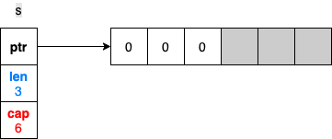
Slices vs. Arrays ( reference )
Go Lang
The data in a slice is stored contiguously in an array. A slice also deals with adding an element if the backing array is full, or shrinking the backing array if it’s near empty.
Internally, a slice holds a pointer to the backing array plus a length and a capacity.
The length is the number of elements the slice contains, whereas the capacity is the number of elements in the backing array, counting from the first element in the slice.
Another implementation of slice discussion
s := make([]int, 3, 6) // declare 3-length, 6-capacity slice
// ^ 2nd arg (capacity) is optional
// zero filled by default

Slide 35
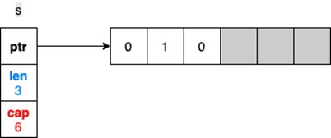
Slices vs. Arrays ( reference )
Go Lang
Make creates an underlying array with 6 elements (capacity), then creates the slice data structure to point to the array
Only the first “len” elements are initialized ( using 0 since the elements are int )
fmt.Println(s) // prints range 0..2, the len, get [ 0 0 0 ]
s[1] = 1 // alters the second element value in the array
No change to len or capacity

Slide 36
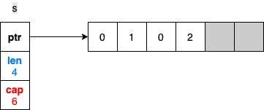
Slices vs. Arrays ( reference )
Go Lang
Accessing an element outside the len range is forbidden, even though the underlying array seems to have space
Use the append built-in function to extend a slice
s[4] = 2 // generates panic, since the slice has no [4] element
s = append(s, 2) // extends slice len, cap stays same
<-- Changes the len
property of the slice

Slide 37
Slices vs. Arrays ( reference )
Go Lang
What happens if we need to add three more elements so that the backing array isn’t large enough?
The append can handle this, and here is what happens
s = append(s, 3, 4, 5)
fmt.Println(s) // output is [0 1 0 2 3 4 5]
<-- might now be garbage
cap is doubled

Slide 38
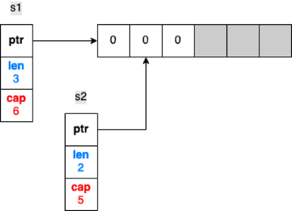
Slices vs. Arrays ( reference )
Go Lang
The old array will be garbage collected (if it is not referenced by other slices)
Slicing can be done on an array or another slice
s1 := make([]int, 3, 6) // Three-length, six-capacity slice
s2 := s1[1:3] // Slicing from indices 1 to (not including) 3
cant go beyond underlying array

Slide 39
Slices vs. Arrays ( reference )
Go Lang
If we update s1[1] or s2[0] ( or any common elements), the change is made to the same array, hence, visible in both slices
s1[1] = 1 // or s2[0] = 1
fmt.Println(s2[0]) // prints 1, both slices see common values

Slide 40
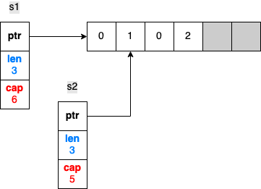
Slices vs. Arrays ( reference )
Go Lang
What happens if we append an element to s2 ? Does this code change s1 as well?
s1
s2 = append(s2, 2)
s2
len of s1 does
not change
<-- len of s2 changes
fmt.Println(s1) // output is [0 1 0]
fmt.Println(s2) // output is [1 0 2]

Slide 41
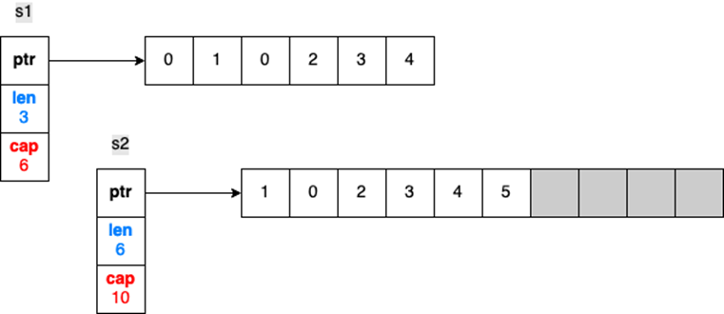
Slices vs. Arrays ( reference )
Go Lang
What if we keep appending elements to s2 until the backing array is full?
Let’s add three more elements so that the backing array will not have enough capacity:
s2 = append(s2, 3)
s2 = append(s2, 4) // At this stage, backing is already full
s2 = append(s2, 5)
s1
<-- double original s2 cap

Slide 42
Array and Slice Example
Go Lang
// example partially generated by chatGPT
package main
import "fmt"
func main() {
// --- Array Example ---
var arr [5]int // Declare an array of length 5
// type is: [5]int array of int length 5
arr[0] = 10 // Assign values to the array
arr[1] = 20
fmt.Println("Array:", arr) // Output: Array: [10 20 0 0 0]
// Accessing array elements by index
fmt.Println("First element of array:", arr[0]) // Output: 10
// Arrays have a fixed size, try to go out of bounds causes an error
// arr[5] = 50 // This would result in a compile-time error
fmt.Println("Array length is ", len(arr)) // Output: Array length is 5
arr[4] = 50 // last element is at subscript length-1
fmt.Println("Array:", arr) // Output: Array: [10 20 0 0 50]
// --- Slice Example ---
sl := make([]int, 3) // Declare a slice of length 3 using make
sl[0] = 100 // Assign values to the slice
sl[1] = 200
fmt.Println("Slice:", sl) // Output: Slice: [100 200 0]

Slide 43
Array and Slice Example
Go Lang
// Accessing slice elements by index
fmt.Println("First element of slice:", sl[0]) // Output: 100
// Slices are dynamic, you can append more elements
sl = append(sl, 400, 500) // Append new values to the slice
fmt.Println("Slice after append:", sl) // Output:
// Slice after append: [100 200 0 400 500]
// Slices can also dynamically grow and shrink in size
fmt.Println("Length of slice:", len(sl)) // Output: 5
fmt.Println("Capacity of slice:", cap(sl)) // Output: 6
// ( capacity may be greater than len
// due to internal optimizations)
// Slices share the underlying array with the original slice
slCopy := sl[:3] // Create a new slice referencing the same underlying array
fmt.Println("Slice copy:", slCopy) // Output: [100 200 0]
slCopy[0] = 999
fmt.Println("Modified Slice Copy:", slCopy) // Output: [999 200 0]
fmt.Println("Original Slice after modifying copy:", sl) // Output: [999 200 0 400 500]

Slide 44
Array and Slice Example
Go Lang
// lets dynamically grow the slice again with an append and see how much
// the capacity goes up
sl = append(sl, 700, 800, 1000) // Append new values to the slice
fmt.Println("Length of slice:", len(sl)) // Output: 8
fmt.Println("Capacity of slice:", cap(sl)) // Output: 12
// ( capacity might be doubled
// over the 6 it had before
// lets dynamically grow it one more time
sl = append(sl, 1, 2, 3, 4, 5) // Append 5 new values to the slice, this
// exceeds the capacity since it is 13 values
fmt.Println("Length of slice:", len(sl)) // Output: 13
fmt.Println("Capacity of slice:", cap(sl)) // Output: 24
// --- Differences between Arrays and Slices ---
// 1. Arrays have a fixed length, slices are dynamic and can grow.
// 2. Arrays cannot be resized, while slices can be resized with append.
// 3. Slices are refs to underlying arrays, changes in one slice can affect others.
}

Slide 45
Closures
Go Lang
When functions are first class entities
A closure is a first class function which captures the lexical bindings of free variables in its defining environment.
Practical definition means a dynamically-created function that can execute properly because the runtime system has set up a collection of any non-local variables it might need
When a function is written its text may depend on variables in the calling environment (globals, vars local to the function calling it, etc.
A closure makes a referencing environment that allows the function to run when called in any circumstances, even ones where the needed environment is not extant
So a closure is a run-time creation… a function and some encapsulated data… whatever it takes to make that function execute as the “definition” suggests when it is called later after creation

Slide 46
Closure Example
Go Lang
package main
import "fmt"
func adder() func(int) int {
sum := 0 // needed by the returned func
// but not inside the func defn
return func(x int) int {
sum += x
return sum
}
}
func main() {
pos, neg := adder(), adder()
// pos and neg are int -> int functions
for i := 0; i < 10; i++ {
fmt.Println( pos(i), neg(-2*i))
}
}

Slide 47
Closure Example in Go
Go Lang
package main
import "fmt"
func adder() func(int) int {
sum := 0
return func(x int) int {
sum += x
return sum
}
}
func main() {
pos, neg := adder(), adder()
for i := 0; i < 10; i++ {
fmt.Println( pos(i), neg(-2*i))
}
}
Closures have some object characteristics
Encapsulation
You can make many of them from one definition

Slide 48
Closure Example
Go Lang
package main // makes closure using a global var
import "fmt"
var g_fac int = 0
func adder() func(int) int {
sum := 0
return func(x int) int {
sum, g_fac = sum+x*(g_fac), g_fac+1
return sum
}
}
func main() {
fmt.Println(g_fac)
g_fac++ // btw in go the inc operator is a statement
// not an expression
fmt.Println(g_fac)
pos, neg := adder(), adder() // both using one global?
for i := 0; i < 10; i++ {
fmt.Println( pos(i), neg(-2*i))
}
}

Slide 49
END

