Slide 1

ON BEYOND OBJECTS PROGRAMMING IN THE 21TH CENTURY COMP 590-059 FALL 2024
David Stotts
Computer Science Dept
UNC Chapel Hill

Slide 2
Shared Data State
Shared read/write variables or data blocks
Scoping must allow data visibility to different code blocks
Code blocks then “execute” concurrently and all read/write the shared data to coordinate and communicate
Even on single CPU system, “virtual” concurrent execution is a good way to think of the computation as progressing
Concurrent tasks might be larger (processes) or medium (threads)
Not usually used for fine-grained parallelism

Slide 3
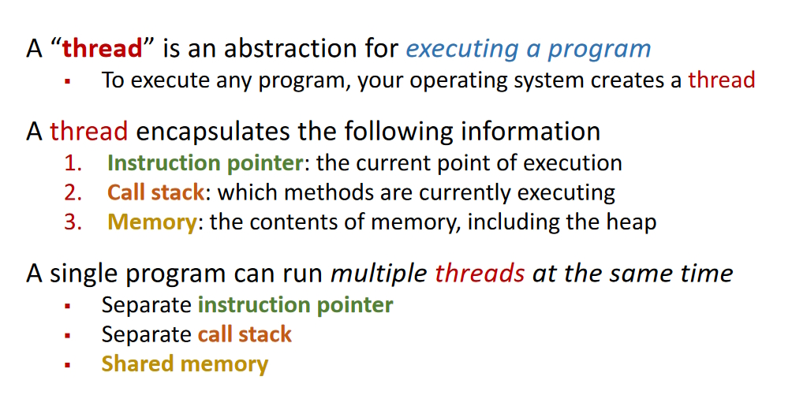
Shared Data State: Threads

Slide 4
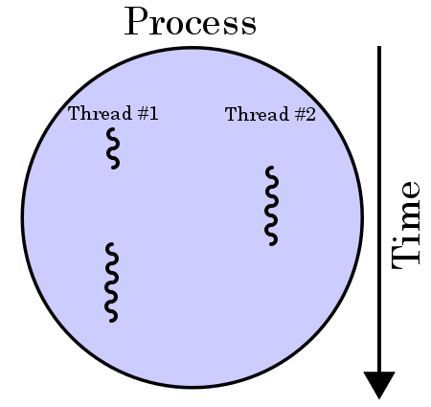
Threads concept
“heavyweight” process comprises one or more “lightweight” threads, computation pieces
All OS now support threads since we run on multi-core CPUs

Slide 5
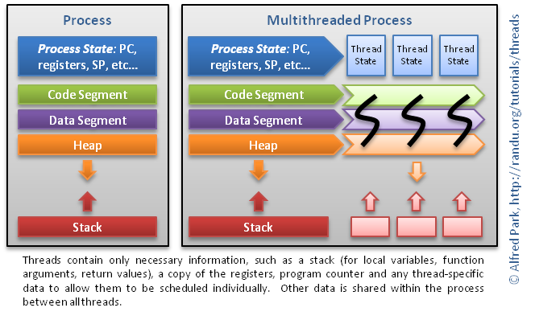
Threads: runtime

Slide 6
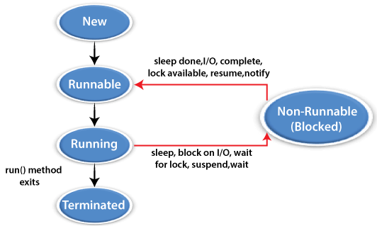
Threads in Java
Java threads are lightweight sub-processes that can share memory
Every Java program has at least one thread… main
Main thread can cause new threads to come into existence and run concurrently
A thread exists in
one of these states

Slide 7
Concurrency via Threads
public class FooStuff extends Thread {
public void run( ) {
System.out.println(“doing foo stuff”);
}
public static void main (String[] args) {
FooStuff thExt = new FooStuff();
thExt.start();
}
}
Making a new Thread
Two ways in Java:
Extend the Thread class
Implement the Runnable interface
Extend the Thread class
Create a thread-intended class that extends Thread
Override the run( ) method
Instantiate an object of your thread-intended class
Have that object invoke its start( ) method
start( ) internally executes the run( ) method you overrode

Slide 8
Concurrency via Threads
public class FooStuff implements Runnable {
public void run( ) {
System.out.println(“doing foo stuff”);
}
public static void main (String[] args) {
Thread thRnb = new Thread(new FooStuff());
thRnb.start();
}
}
Making a new Thread
We would use this approach for a class that already extends some parent class, but needs thread capability
Java wont allow multiple inheritance (extends)
Implement the Runnable interface
Create a thread-intended class that implements Runnable
Code up the run( ) method
Instantiate an object of Thread class, pass a new thread-intended class object to the Thread constructor
Have that object invoke its start( ) method
start( ) internally executes the run( ) method you overrode

Slide 9
Threads in Java
https://www.geeksforgeeks.org/synchronization-in-java/
Examples of making and using threads in Java
Synchronized blocks and methods
Also shows (as we did in COMP 301) the use of anonymous classes to easily specify smaller threads

Slide 10
Task Synchronization Issues
Issues of concurrent tasks interfering on shared data
Busy waiting (spin waiting)
Race conditions
Deadlock
Starvation
Ways to keep tasks from doing this
Test-and-set ( hardware atomic, also software version)
Spin waiting
Mutex lock
Semaphores
Monitors

Slide 11
Back to Java Threads
More on how to manage concurrency issues

Slide 12
Java threads
codes from
Marko Dvečko
Counting
public class Counting { public static void main(String[] args) throws InterruptedException { class Counter { int counter = 0; public void increment() { counter++; } public int get() { return counter; } } final Counter counter = new Counter(); class CountingThread extends Thread { public void run() { for (int x = 0; x < 500000; x++) { counter.increment(); } } }
CountingThread t1 = new CountingThread(); CountingThread t2 = new CountingThread(); t1.start(); t2.start(); t1.join(); t2.join(); System.out.println(counter.get()); } }
Run this and we get 673194
Or then 599213 or 879943
We expect 1000000
But get something different every run (non determinism)
This increment is not executing atomically
This is a race condition
One way threads interfere with each others’ correct use of the shared resource

Slide 13
Java threads
codes from
Marko Dvečko
Counting
public class Counting { public static void main(String[] args) throws InterruptedException { class Counter { int counter = 0; public void increment() { counter++; } public int get() { return counter; } } final Counter counter = new Counter(); class CountingThread extends Thread { public void run() { for (int x = 0; x < 500000; x++) { counter.increment(); } } }
CountingThread t1 = new CountingThread(); CountingThread t2 = new CountingThread(); t1.start(); t2.start(); t1.join(); t2.join(); System.out.println(counter.get()); } }
This increment looks atomic but at the assembly level several distinct things happen
task reads a value into register (R)
add 1 to register (A)
write register back to memory (W)
If R2 happens before W1, any interleaving like this will leave one increment instead of two
Two tasks 1 and 2 doing ++ “same time” might badly interleave these 6 actions
R1, R2, A1, A2, W1, W2
Causes two “increments” to leave the counter with a single increase in value

Slide 14
CountingBetter
import java.util.concurrent.atomic.AtomicInteger; class CountingBetter { public static void main(String[] args) throws InterruptedException { final AtomicInteger counter = new AtomicInteger(0); class CountingThread extends Thread { public void run() { for (int i = 0; i < 500000; i++) { counter.incrementAndGet(); } } } CountingThread thread1 = new CountingThread(); CountingThread thread2 = new CountingThread(); thread1.start(); thread2.start(); thread1.join(); thread2.join(); System.out.println(counter.get()); } }
One solution: atomic integers in Java for the counter
This method in the class allows only one thread to access the counter object for the duration of the read and update

Slide 15
Deadlock
public class Deadlock {
public static void main(String[] args) throws InterruptedException {
class Account {
int balance = 100;
public Account(int balance) { this.balance = balance; }
public synchronized void deposit(int amount) { balance += amount; }
public synchronized boolean withdraw(int amount) {
if (balance >= amount) { balance -= amount; return true; }
return false;
}
public synchronized boolean transfer(Account destination, int amount) {
if (balance >= amount) {
balance -= amount;
synchronized(destination) { destination.balance += amount; };
return true;
}
return false;
}
public int getBalance() { return balance; }
}
Problem when one Account obj wants to send to a different Account obj

Slide 16
Deadlock (cont.)
final Account bob = new Account(200000);
final Account joe = new Account(300000);
class FirstTransfer extends Thread {
public void run() {
for (int i = 0; i < 100000; i++) {
bob.transfer(joe, 2);
} } }
class SecondTransfer extends Thread {
public void run() {
for (int i = 0; i < 100000; i++) {
joe.transfer(bob, 1);
} } }
FirstTransfer thread1 = new FirstTransfer();
SecondTransfer thread2 = new SecondTransfer();
thread1.start(); thread2.start();
thread1.join(); thread2.join();
System.out.println("Bob's balance: " + bob.getBalance());
System.out.println("Joe's balance: " + joe.getBalance());
}
}
concurrent
Two different objects, and sync methods are object level, not class level

Slide 17
Semaphore
-ish
Proposed by E. W. Dijkstra, 1962
Programming mechanism to control mutually exclusive access of concurrent tasks on a shared resource
An integer which in its simplest form is binary… contains 0 or 1
Initialized to 1, and counts the number of available “free” resources
Two standard atomic operations: wait (P), and signal (V)
P (Semaphore s) {
// process wants to use a critical resource
while (s <= 0) {
// no operation
// some other task has shared resource
}
s-- ; // atomic
// num in critical section, has access to
// the shared resource
}
V (Semaphore s) {
s++ ; // atomic
// task doing the V is releasing the shared
// resource, and leaving the critical section
}
almost . . .
“spin waiting”

Slide 18
Semaphore
Fix for spin wait: task queue
Every semaphore has an associated queue of tasks/threads
Spin wait is replaced with a task being suspended and waiting inactive is a queue of tasks; if s == 0 ( the resource is busy ) the task is put on the queue
All tasks in queue are waiting on the same semaphore, waiting for the protected resource to come available
Use FIFO queue to ensure lack of starvation (every task eventually gets the resource)
V op checks queue and wakes first task… or else increments s variable
P (Semaphore s) {
// process wants to use a critical resource
if (s <= 0) {
// this task is put on s wait que
// and suspended
}
// when task gets here, it has been taken
// off s wait que and awakened (OS op)
s-- ; // atomic
}
V (Semaphore s) {
if empty(s.que) { s++ }
else {
// head of s.que is taken off
// and awakened to execute here
}

Slide 19
Semaphore Variant, Generalization
Mutex, and more than 1 resource
Semaphore initialized to 1 is called a binary semaphore
This often colloquially termed a “mutex” or “mutex lock”
Mutex is binary ... resource is locked, or not
Assumption in using a true mutex is that the task that takes the lock must also be the task that releases the lock
Semaphore can generalize to cover more than one resource
Simply initialize the semaphore value to more than 1… e.g. if you have K of some resource that requires mutual exclusion then set s=K to start.
Each P operation decrements s, until s becomes 0, which signals that K tasks are using the K resources concurrently
Each V operation increments s.
Semaphore initialized to K > 1 is called a counting semaphore

Slide 20
Monitor ( wiki )
Concurrency control mechanism
Per Brinch Hansen, C.A.R. Hoare (c. 1973)
Class-like structure wrapping a shared resource, allowing locking and mutual exclusion (mutex)
Also gives threads the ability to wait (block) for a certain condition to become false.
A monitor consists of a mutex (lock) object and condition variables.
A condition “variable” essentially is a container of threads that are waiting for a certain condition.
Monitors provide a mechanism for threads to temporarily give up exclusive access in order to wait for some condition to be met, before regaining exclusive access and resuming their task.

Slide 21
Monitor
Overall Pattern
monitor class Account {
private int balance := 0 invariant balance >= 0
public method boolean withdraw(int amount)
precondition amount>=0 {
if balance < amount { return false }
else {
balance := balance - amount
return true
}
}
public method deposit(int amount)
precondition amount >= 0 {
balance := balance + amount
}
}

Slide 22
Monitor
Internal effect is this
class Account {
private lock myLock
private int balance := 0 invariant balance >= 0
public method boolean withdraw(int amount) precondition amount >= 0 {
myLock.acquire()
try {
if balance < amount { return false }
else {
balance := balance - amount
return true
}
} finally { myLock.release() }
}
public method deposit(int amount) precondition amount >= 0 {
myLock.acquire()
try { balance := balance + amount }
finally { myLock.release() }
}
}

Slide 23
Mutex not enough
Threads can deadlock
In general, threads attempting some op in a monitor may need to wait until some condition P holds on the state of the monitor’s shared data
A busy waiting loop wont work here
while not( P ) do skip
Why not?
A thread doing this is in the monitor, and has the mutex lock
Thus, no other thread can enter the monitor to change the data state and make P true
Need a way to pause the thread, and then signal it back to running when the condition P is true (or could be true).
condition variables

Slide 24
Example Issues
Busy Waiting
global RingBuffer queue; // A thread-unsafe ring-buffer of tasks
// Method representing each producer thread's behavior
public method producer() {
while (true) {
task myTask = ...; // Produce some new task to be added
while (queue.isFull()) {} // Busy-wait until the queue is non-full
queue.enqueue(myTask); // Add the task to the queue
}
}
// Method representing each consumer thread's behavior
public method consumer() {
while (true) {
while (queue.isEmpty()) {} // Busy-wait until the queue is non-empty
myTask = queue.dequeue(); // Take a task off of the queue
doStuff(myTask); // Go off and do something with task
}
}
race conditions, mess up queue state

Slide 25
Example Issues
Spin Waiting (spin lock)
a mutex is used to protect the critical sections of code
busy-waiting is still used
the lock is acquired and released in between each busy-wait check
global RingBuffer queue; // A thread-unsafe ring-buffer of tasks
global Lock queueLock; // A mutex for the ring-buffer of tasks
// Method representing each producer thread's behavior
public method producer() {
while (true) {
task myTask = ...; // Producer makes some new task to be added
queueLock.acquire(); // Acquire lock for initial busy-wait check
while (queue.isFull()) { // Busy-wait until the queue is non-full
queueLock.release();
// Drop the lock temporarily to allow a chance for other threads
// needing queueLock to run so that a consumer might take a task
queueLock.acquire(); // Re-acquire lock for the next call to "queue.isFull()"
}
queue.enqueue(myTask); // Add the task to the queue
queueLock.release(); // Drop queue lock until we need it again to add the next task
}
}

Slide 26
Example Issues
Spin Waiting
// Method representing each consumer thread's behavior
public method consumer() {
while (true) {
queueLock.acquire(); // Acquire lock for initial busy-wait check
while (queue.isEmpty()) { // Busy-wait until the queue is non-empty
queueLock.release();
// Drop the lock temporarily to allow a chance for other threads
// needing queueLock to run so that a producer might add a task
queueLock.acquire(); // Re-acquire the lock for the next
// call to "queue.isEmpty()"
}
myTask = queue.dequeue(); // Take a task off of the queue
queueLock.release(); // Drop queue lock until need it
// again to take off the next task
doStuff(myTask); // Go off and do something with the task
}
}

Slide 27
Example Issues
Spin Waiting
Well, it’s a solution: assures inconsistent shared state does not occur
But it’s not an efficient solution
wastes CPU resources due to so much busy-waiting
even if the queue is empty and producer threads have nothing to add for a long time, consumer threads are always busy-waiting (for nothing)
likewise, if consumers are blocked for a long time on current tasks and the queue is full, producers are busy-waiting, consuming CPU cycles
need a way to make producer threads block until the queue is non-full, and a way to make consumer threads block until the queue is non-empty.

Slide 28
Monitor condition variables
These are pools (queues) of threads
Conceptually a condition variable is a queue of threads, associated with a mutex, on which a thread may wait for some condition to become true
Each condition variable c is associated with an assertion Pc
While a thread is waiting on some c , that thread is not considered to occupy the monitor . . . so other threads may enter the monitor to change the monitor's state
In most types of monitors, these other threads may signal the condition variable c to indicate that assertion Pc is true in the current monitor data state.

Slide 29
signal c, also known as notify c
Monitor condition variables
Three main operations on condition variables
wait c, m
where c is a condition var and m is a mutex (lock) of the monitor
signal c ( also known as notify c )
called by a thread to indicate that the assertion Pc is true
broadcast c ( also known as notifyAll c )
similar op to signal, but wakes up all threads in c's wait-queue

Slide 30
NonDeterminism
public class NonDeterminism { public static void main(String[] args) throws InterruptedException { class Container { public String value = "Empty"; } final Container container = new Container(); class FastThread extends Thread { public void run() { container.value = "Fast"; } } class SlowThread extends Thread { public void run() { try { Thread.sleep(50); } catch(Exception e) {} container.value = "Slow"; } } FastThread fast = new FastThread(); SlowThread slow = new SlowThread(); fast.start(); slow.start(); fast.join(); slow.join(); System.out.println(container.value); } }

Slide 31
Thread Control
Methods to control thread execution and state
These methods are from Thread class
public static void sleep( long millis ) throws InterruptedException
public static void yield( )
public final void join( ) throws InterruptedException
public final void setPriority( int newPriority )
Methods from Object class
public final void wait( ) throws InterruptedException
public final void notify( )
public final void notifyAll( )

Slide 32
Thread Control
Methods to control thread execution and state
Thread tt = new Thread( ); // th state new
tt.start( ); // th state runnable and running
tt.join( ); // current thread (like main) waits for tt run to end
tt.yield( );
tt.sleep(1000); // in millisecs
tt.sleep(0,200); // in nanosecs, 0 milli plus 200 nano

Slide 34
Concurrently executing threads
… may interact in ways that prevent successful conclusion of the desired overall computation
Deadlock
Starvation
Race conditions (data race, lost update)
Livelock
Fairness
Ordering / Happens-Before Violations
Priority Inversion
Over-Synchronization

Slide 35
A Unifying Mental Model
Concurrency failures arise when you lose track of:
Who owns the data?
Who is allowed to mutate it?
When are changes visible?
What ordering is guaranteed?
What progress guarantees exist?
Languages differ mainly in which of these they emphasize and/or enforce by default:
Java: shared memory + locks
Go: shared memory + channels (by convention)
Erlang/Elixir: isolation + message passing
Rust: ownership + compile-time enforcement

Slide 36
Reasoning about correctness
Reasoning about correctness is
the process of arguing ( systematically and convincingly )
that a program does what it is intended to do
under all allowed conditions
– not just in observed executions
It is not testing.
It is not “ it seems to work.”
It is a discourse grounded in semantics, invariants, assumptions, and provable inferences

Slide 37
Define Deadlock
Informal: A set of concurrent threads is deadlocked when ALL of them may make no progress
We tend to use this kind of informal “definition” in conversation. We might say “the system is deadlocked” to say nothing useful is happening
However, this is too broad, collapses several distinct failure modes into one
Better, more formal: Deadlock exists iff there is a nonempty set of threads such that each thread is blocked waiting for a resource held by another thread in the same set.
Deadlock is a permanent blocking state caused by circular dependencies on resources, not merely by lack of progress.
All deadlocks cause lack of progress,
… but not all lack of progress is deadlock.

Slide 38
Deadlock (cont.)
A deadlock exists iff:
There exists a nonempty set of threads D such that:
– Every thread in D is blocked (cannot proceed), – Each thread in D is waiting for a resource or condition that can be satisfied only by another thread in D, and – No thread outside D can enable any thread in D to proceed.
This makes a deadlock a closed waiting set
Or (graph-theoretic): The wait-for graph contains a cycle
So we dont say “the system is deadlocked”
We say “there is a deadlock in the program”

Slide 39
Examples
A system has 10 threads; T1 holds a lock (locked resource), and the other 9 are waiting for it; T1 is in an infinite loop and will not ever release the lock, but it runs.
Is this deadlocked? Is there a deadlock?
A system has 10 threads; T1 holds a lock (locked resource), and the other 9 are waiting for it; then T1 suffers failure (like divide-by-zero) and ends with the lock held.
Is this deadlocked? Is there a deadlock?

Slide 40
Examples
A system has 10 threads; T1 through T8 are cranking away generating results; T9 is blocked waiting for a lock T10 has, and T10 is blocked waiting for a lock T9 has.
Is this deadlocked? Is there a deadlock?
A system has 10000 threads; 9997 of them are cranking away generating results; T1 holds a lock, and is blocked waiting for a lock held by T2; T2 is blocked waiting for a lock held by T3; T3 is blocked waiting for the lock T1 holds.
Is this deadlocked? Is there a deadlock?

Slide 41
Examples
A system has 10000 threads; 9997 of them are cranking away generating results; T1 holds a lock, and is blocked waiting for a lock held by T2; T2 is blocked waiting for a lock held by T3; T3 is executing painfully slowly, making miniscule progress (but so far not in a inf-loop or error).
Is this deadlocked? Is there a deadlock?

Slide 42
The Coffman Conditions (for Deadlock)
E. G. Coffman, Jr., M. Elphick, and A. Shoshani
“ System Deadlocks “
ACM Computing Surveys, Vol. 3, No. 2, June 1971, pp. 67–78
This paper:
Introduced the four conditions explicitly
Formalized deadlock in operating systems
four necessary conditions for a deadlock to be possible in a concurrent system.
-- Mutual Exclusion
-- Hold and Wait
-- No Preemption
-- Circular Wait
Key Theorem
Deadlock is possible if and only if all four Coffman conditions hold simultaneously
So to prove deadlock freedom, it is sufficient to show that one condition is impossible in your system.

Slide 43
Coffman Conditions (for Deadlock)
Mutual Exclusion
At least one resource is non-sharable.
A resource can be held by only one thread/process at a time.
Typical examples: mutexes, monitors, exclusive file locks.
If all resources are shareable (read-only, immutable, etc.), deadlock won't occur.
Hold and Wait
A thread holds at least one resource while waiting for another.
The thread does not release what it already holds.
Example: a thread holds lock A and requests lock B.
If threads must request all needed resources at once (or release before requesting more), deadlock is prevented.

Slide 44
Coffman Conditions (for Deadlock)
No Preemption
Resources cannot be forcibly taken away.
A resource is released only voluntarily by the holder
The system cannot “steal” a lock from a thread
If the system can preempt resources (e.g., roll back a transaction and reclaim locks), deadlock is impossible
Circular Wait
There exists a cycle of threads each waiting for a resource held by the next.
T₁ waits for T₂
T₂ waits for T₃ …
Tₙ waits for T₁
This is precisely what appears as a cycle in a wait-for graph.

Slide 45
Coffman Conditions (for Deadlock)
Coffman is a possibility theorem, not a prediction theorem.
Deadlock is possible if and only if all four conditions hold simultaneously
Which means:
If any one condition is absent → deadlock is impossible
If all four are present → deadlock is not ruled out, might happen
if all four are present → deadlock might not happen
Even if all four Coffman conditions hold:
Deadlock may never occur
Deadlock may occur only under rare interleavings
Deadlock may be prevented by protocol discipline (good coding)

Slide 46
Coffman Example
Locks: A and B, and Threads: T1 and T2
– Both locks are exclusive
– Threads may hold one lock while waiting for the other
– Locks cannot be preempted
– Circular wait possible if T1 and T2 each need both locks
Four Coffman conditions hold… so… deadlock?
Not necessarily
If your code has “Always acquire A before B” ordering on locks… then
no circular wait can arise ( eliminates one Coffman condition )
deadlock will never occur
So the system structure allows deadlock, but the protocol prevents it.

Slide 47
Coffman Summary
Why they matter (conceptually)
The Coffman conditions are about execution semantics, not code structure.
They explain why deadlock can happen, not when it will.
They give you design levers:
-- break any one condition → deadlock freedom.
Important clarifications (often confused)
Coffman conditions do not guarantee deadlock.
They characterize possibility, not inevitability.
They are not directly about starvation or fairness.
They are a foundation for reasoning about deadlock avoidance and prevention.
Typical prevention strategies (break conditions)
Mutual exclusion | Use immutable data, lock-free algorithms
Hold and wait | Acquire all locks at once
No preemption | Timeouts, rollback, transaction abort
Circular wait | Global lock ordering

Slide 48
Deadlock vs. Starvation
Deadlock vs. starvation: what kind of failure?
Deadlock
Safety-style property: “The system reaches a bad state.”
Once in that state, no progress is possible.
Characterized by a finite structural witness:
A cycle in a wait-for graph.
Coffman conditions apply because they describe resource structure.
Starvation
Liveness-style property: “Something good never happens.”
The system continues to run, but:
One (or more) threads are perpetually postponed.
There is no finite bad state.
There is no single snapshot that “proves” starvation.
This distinction alone forces different reasoning tools.

Slide 49
Deadlock vs. Starvation
Coffman conditions answer
Can the system reach a state where nobody can proceed?:
Starvation asks:
Can the system overall keep making progress forever while some thread never does?
A system can violate none of the Coffman conditions and still starve:
No circular wait
No hold-and-wait
No deadlock
Yet one thread never acquires a resource
Example: A mutex with unfair scheduling
Example: Dining Philos (naieve)

Slide 51
END

