Slide 1
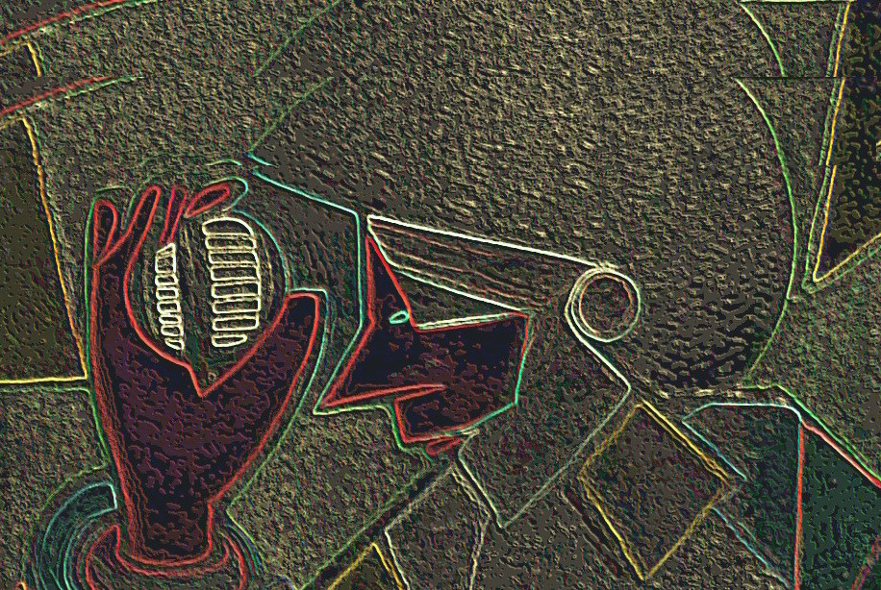
On Beyond Objects Programming in the 21th century COMP 590-059 Spring 2026
David Stotts
Computer Science Dept
UNC Chapel Hill

Slide 2
Go Struct vs. class

Slide 3
01
Go struct ≈ Java class
The struct is the closest Go equivalent — but Go deliberately splits what Java bundles into one declaration.
Rectangle.java
Java
rectangle.go
Go
public class Rectangle {
// fields (private by convention)
private double width;
private double height;
// constructor
public Rectangle(double w, double h) {
this.width = w;
this.height = h;
}
// method
public double area() {
return width * height;
}
public double perimeter() {
return 2 * (width + height);
}
}
// data only — no methods inside
type Rectangle struct {
width float64 // lowercase = unexported
height float64
}
// "constructor" — just a function by convention
func NewRectangle(w, h float64) Rectangle {
return Rectangle{width: w, height: h}
}
// methods live outside the struct
func (r Rectangle) Area() float64 {
return r.width * r.height
}
func (r Rectangle) Perimeter() float64 {
return 2 * (r.width + r.height)
}
vs
Java bundles data + behavior + visibility + constructor into one class block. Go separates them — struct holds data, methods are defined outside, visibility is just capitalization.

Slide 4
02
What Java Puts in a Class — How Go Splits It Up
Go intentionally separates concerns that Java bundles together. Each has its own construct.
Concern
Java
Go
Note
Data / Fields
private double width;
private double height;
type Rectangle struct {
width float64
height float64
}
struct holds the data
Behavior / Methods
public double area() {
return width * height;
}
func (r Rectangle) Area() float64 {
return r.width * r.height
}
defined outside struct, anywhere in package
Constructor
public Rectangle(double w, double h) {
this.width = w;
}
func NewRectangle(w, h float64) Rectangle {
return Rectangle{width:w, height:h}
}
just a plain function — no special syntax
Interfaces / Contracts
public class Rect implements Shape {
// must declare intent
}
// nothing! if Area() exists, Rectangle
// automatically satisfies Shape
implicit — duck typing at the type level
Access Control
private double width; // field
public double Area() { }
width float64 // unexported (lowercase)
Area() float64 // exported (Uppercase)
capitalization only — no keywords
Go's separation is intentional: a struct never declares what interfaces it implements. If the methods match, it satisfies the interface automatically — anywhere, by anyone.

Slide 5
03
The Key Philosophical Difference — Implicit Interfaces
Java requires you to declare intent. Go infers it. This changes how you design abstractions.
Java
Go
You must declare your intent up front.
Satisfaction is inferred — no declaration needed.
Shape.java
Java
shape.go
Go
public interface Shape {
double area();
}
// Rectangle must DECLARE it implements Shape
public class Rectangle implements Shape {
public double area() { return width * height; }
}
type Shape interface {
Area() float64
}
// Rectangle says NOTHING about Shape.
// It just has an Area() method.
// That's enough — it satisfies Shape automatically.
vs
Consequence
Consequence
Rectangle is permanently coupled to the Shape interface. To implement a second interface from a third-party library, you must modify Rectangle — or wrap it. You can't retrofit interfaces you don't own.
Any type with an Area() method satisfies Shape — including types in other packages that were written before Shape existed. You can define interfaces against types you don't own. Abstractions emerge rather than being planned.
This is why Go code tends toward small, single-method interfaces (io.Reader, io.Writer, fmt.Stringer). They're easy to satisfy accidentally — which is the point.

Slide 6
04
Creating Instances
Java always uses new. Go has several options — struct literals, constructor functions, and new().
Main.java
Java
main.go
Go
// Java — always use new keyword
Rectangle r1 = new Rectangle(5.0, 3.0);
// With var (Java 10+)
var r2 = new Rectangle(10.0, 4.0);
// Array of objects — each needs new
Rectangle[] shapes = {
new Rectangle(1.0, 2.0),
new Rectangle(3.0, 4.0),
};
// Go — option 1: struct literal (most common)
r1 := Rectangle{width: 5.0, height: 3.0}
// option 2: constructor function (when you need validation)
r2 := NewRectangle(10.0, 4.0)
// option 3: new() — returns a *pointer*, zero-valued
r3 := new(Rectangle) // r3.width==0, r3.height==0
// slice of structs — no "new" needed
shapes := []Rectangle{
{width: 1.0, height: 2.0},
{width: 3.0, height: 4.0},
}
vs
Java: new is mandatory
Go: struct literals are values
Every object creation goes through new. The constructor is a special method — same name as the class, no return type. Objects always live on the heap.
Struct literals create value types by default — they can live on the stack. Use & or new() when you need a pointer. Constructor functions (New...) are just conventions, not language features.
Go structs are values — assigning one copies it (like int or float). Java objects are always references. This is the single biggest day-to-day behavioral difference.

Slide 7
05
Using Instances — Methods, Fields, Passing Around
Dot notation is the same. The difference is value vs reference semantics when passing to functions.
Usage.java
Java
usage.go
Go
var r = new Rectangle(5.0, 3.0);
// calling methods — dot notation
double a = r.area(); // 15.0
double p = r.perimeter(); // 16.0
// Java objects are REFERENCES
// passing to a function shares the object
printInfo(r); // r is a reference
// modifying inside a method affects the caller
static void stretch(Rectangle r) {
r.width = r.width * 2; // mutates caller's object!
}
stretch(r);
System.out.println(r.area()); // 30.0 — changed!
r := Rectangle{width: 5.0, height: 3.0}
// calling methods — same dot notation
a := r.Area() // 15.0
p := r.Perimeter() // 16.0
// Go structs are VALUES
// passing to a function COPIES the struct
printInfo(r) // r is copied
// to mutate, use a pointer receiver
func stretch(r *Rectangle) {
r.width = r.width * 2 // mutates via pointer
}
stretch(&r) // pass address explicitly
fmt.Println(r.Area()) // 30.0 — changed via pointer
vs
Value receiver func (r Rectangle) Area() r is a copy — safe for reads
Pointer receiver func (r *Rectangle) Scale() r is a pointer — can mutate
In Go, choose value receiver when the method only reads. Choose pointer receiver when it needs to mutate, or when the struct is large and you want to avoid copying.

Slide 8
06
Putting It Together — A Complete Working Example
Structs in slices, ranging over them, using interfaces. This is idiomatic Go.
ShapeDemo.java
Java
shapes.go
Go
interface Shape {
double area();
String name();
}
class Rectangle implements Shape {
private double w, h;
Rectangle(double w, double h) { this.w=w; this.h=h; }
public double area() { return w * h; }
public String name() { return "Rectangle"; }
}
class Circle implements Shape {
private double r;
Circle(double r) { this.r = r; }
public double area() { return Math.PI * r * r; }
public String name() { return "Circle"; }
}
public class ShapeDemo {
public static void main(String[] args) {
Shape[] shapes = {
new Rectangle(5, 3),
new Circle(4),
};
for (Shape s : shapes) {
System.out.printf("%s area: %.2f%n",
s.name(), s.area());
}
}
}
type Shape interface {
Area() float64
Name() string
}
type Rectangle struct{ W, H float64 }
func (r Rectangle) Area() float64 { return r.W * r.H }
func (r Rectangle) Name() string { return "Rectangle" }
type Circle struct{ R float64 }
func (c Circle) Area() float64 { return math.Pi * c.R * c.R }
func (c Circle) Name() string { return "Circle" }
func main() {
shapes := []Shape{
Rectangle{W: 5, H: 3},
Circle{R: 4},
}
for _, s := range shapes {
fmt.Printf("%s area: %.2f
",
s.Name(), s.Area())
}
}
// Rectangle area: 15.00
// Circle area: 50.27
vs
Rectangle and Circle explicitly declare implements Shape.
Rectangle and Circle say nothing about Shape. They just have the methods — Go figures the rest out.
Notice: the Go interface and the structs that satisfy it can live in completely separate packages — neither needs to know about the other at the time of writing.

