Slide 1
Relations and Functions

Slide 2
The Language of Relations and Functions
The objects of mathematics may be related in various ways.
A set A may be said to be “related to” a set B if A is a subset of B, or if A is not a subset of B, or if A and B have at least one element in common.
A number x may be said to be “related to” a number y if
x < y, or if x is a factor of y, or if x² + y² = 1.

Slide 3
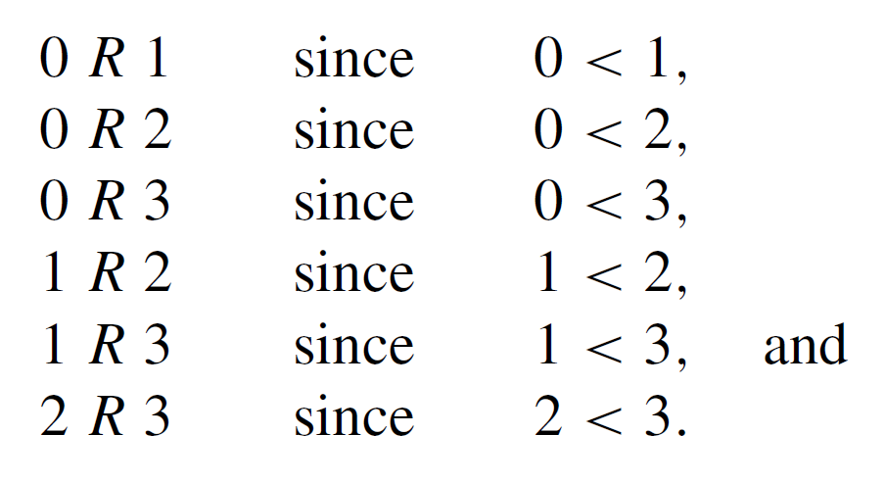
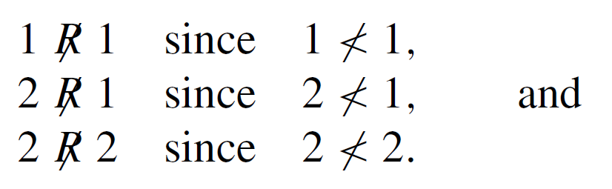

The Language of Relations and Functions
Let A = {0, 1, 2} and B = {1, 2, 3} and let us say that x ∈ A is related to y ∈ B if and only if x < y.
Use the notation “x R y” as a shorthand for the sentence “x is related to y.” Then
On the other hand, if the “ ” represents the sentence “x is not related to y,” then

Slide 4
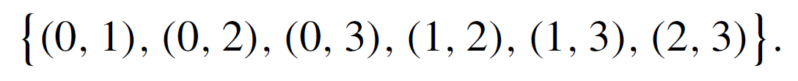
The Language of Relations and Functions
Now consider
In some elements of A × B, the first and second components are related by R, whereas other elements do not have this property.
Consider the set of all ordered pairs in A × B whose elements are related by R:

Slide 5
The Language of Relations and Functions
Observe that knowing which ordered pairs lie in this set is equivalent to knowing which element consist of components related by R.
The relation itself can therefore be thought of as the ordered pairs whose elements are related by R.
Definition: Let A and B be sets. A relation R from A to B is a subset of A x B. If (x, y) ∈ A x B, then x R y if and only if (x, y) ∈ R.
A is called the domain of R
B is called the co-domain of R

Slide 6

The Language of Relations and Functions
The notation for a relation R may be written symbolically as follows:
x R y means that (x, y ) ∈ R.
The notation x y means that x is not related to y by R:
x y means that (x, y ) ∉ R.

Slide 7
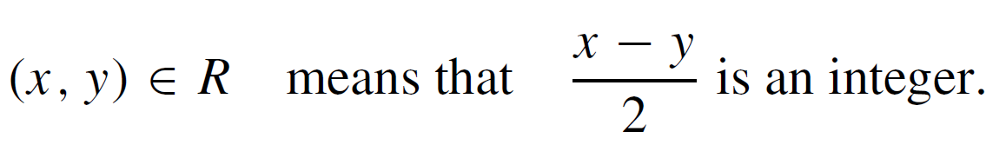
Example 1 – A Relation as a Subset
Let A = {1, 2} and B = {1, 2, 3} and define a relation R from A to B as follows: Given any (x, y) ∈ A × B,
a. State explicitly which ordered pairs are in A × B and
which are in R.
b. Is 1 R 3? Is 2 R 3? Is 2 R 2?
c. What are the domain and co-domain of R?

Slide 8
Example 1 – Solution
a. A × B = {(1, 1), (1, 2), (1, 3), (2, 1), (2, 2), (2, 3)}. To
determine explicitly the composition of R, examine each
ordered pair in A × B to see whether its elements satisfy
the defining condition for R.

Slide 9

Example 1 – Solution
cont’d
Thus
b.
c.

Slide 10
Arrow Diagram of a Relation

Slide 11
Arrow Diagram of a Relation
Suppose R is a relation from a set A to a set B. The arrow diagram for R is obtained as follows:
Represent the elements of A as points in one region and the elements of B as points in another region.
For each x ∈ A and y ∈ B, draw an arrow from x to y if,
and only if x R y.

Slide 12
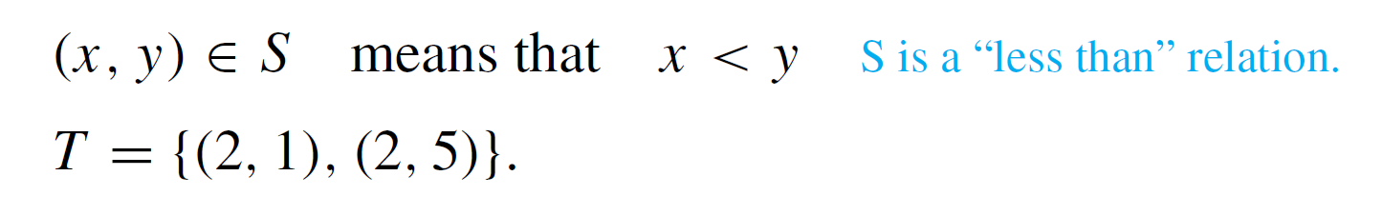
Example 3 – Arrow Diagrams of Relations
Let A = {1, 2, 3} and B = {1, 3, 5} and define relations S and T from A to B as follows:
For all (x, y ) ∈ A × B,
Draw arrow diagrams for S and T.

Slide 13
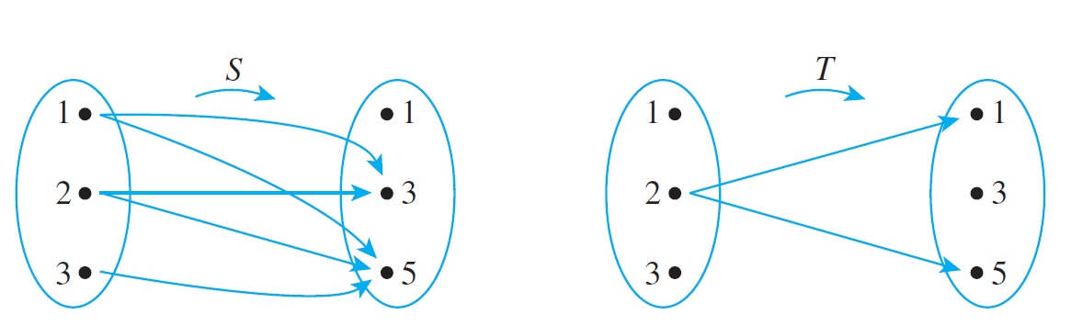
Example 3 – Solution
These example relations illustrate that it is possible to have several arrows coming out of the same element of A pointing in different directions.
Also, it is quite possible to have an element of A that does not have an arrow coming out of it.

Slide 14
Functions

Slide 15
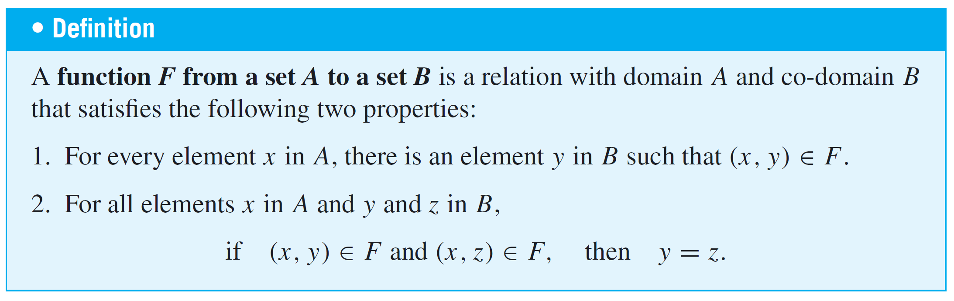
Functions

Slide 16
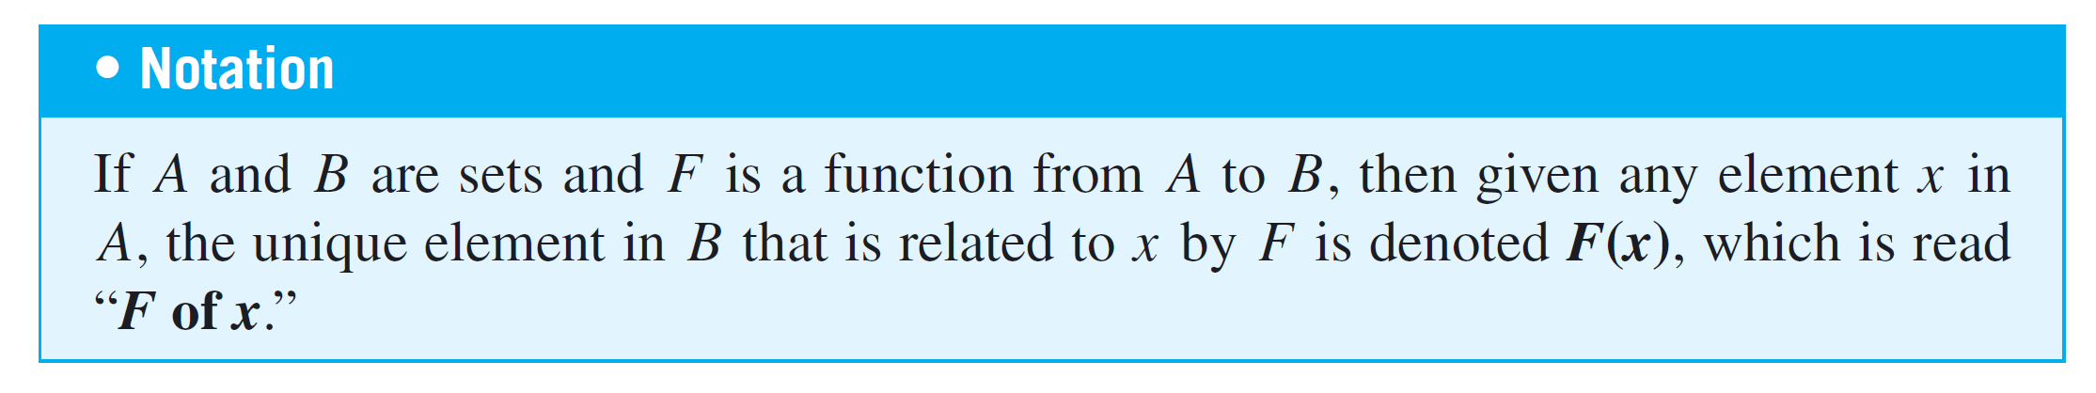
Functions
Properties (1) and (2) can be stated less formally as follows: A relation F from A to B is a function if, and only if:
1. Every element of A is the first element of an ordered pair
of F.
2. No two distinct ordered pairs in F have the same first
element.

Slide 17
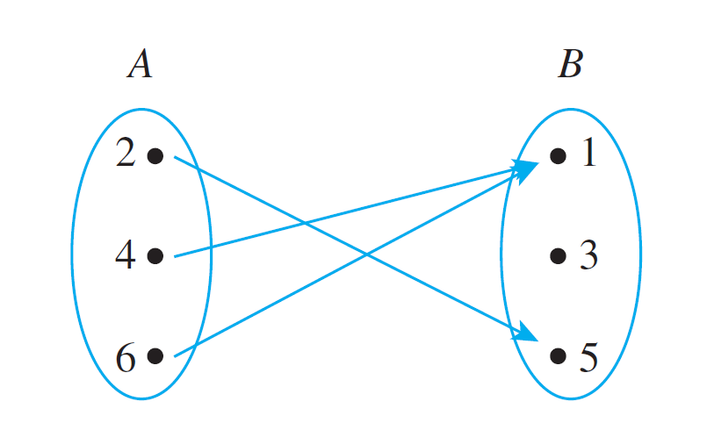
Example 4 – Functions and Relations on Finite Sets
Let A = {2, 4, 6} and B = {1, 3, 5}. Which of the relations R, S, and T defined below are functions from A to B?
a. R = {(2, 5), (4, 1), (4, 3), (6, 5)}
b. For all (x, y ) ∈ A × B, (x, y ) ∈ S means that y = x + 1.
c. T is defined by the arrow diagram

Slide 18
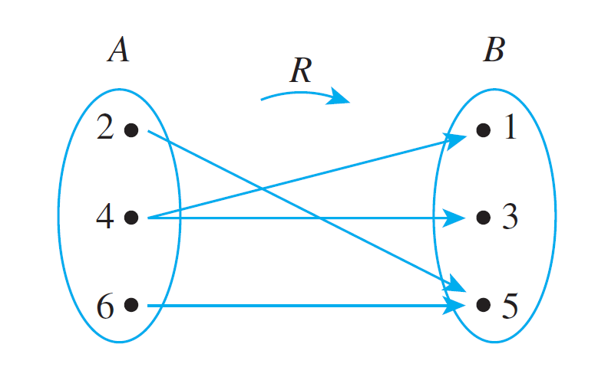
Example 4(a) – Solution
R is not a function because it does not satisfy property (2). The ordered pairs (4, 1) and (4, 3) have the same first element but different second elements.
You can see this graphically if you draw the arrow diagram for R. There are two arrows coming out of 4: One points to 1 and the other points to 3.

Slide 19
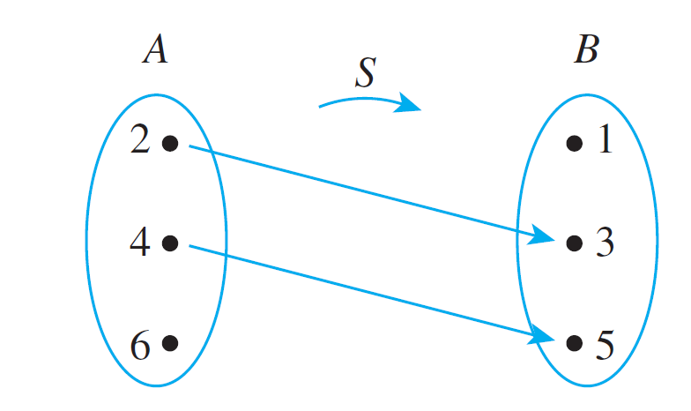
Example 4(b) – Solution
cont’d
S is not a function because it does not satisfy property (1). It is not true that every element of A is the first element of an ordered pair in S.
For example, 6 ∈ A but there is no y in B such that
y = 6 + 1 = 7. You can also see this graphically by drawing the arrow diagram for S.

Slide 20
Example 4(c) – Solution
cont’d
T is a function: Each element in {2, 4, 6} is related to some element in {1, 3, 5} and no element in {2, 4, 6} is related to more than one element in {1, 3, 5}.
When these properties are stated in terms of the arrow diagram, they become (1) there is an arrow coming out of each element of the domain, and (2) no element of the domain has more than one arrow coming out of it.
So you can write T (2) = 5, T (4) = 1, and T (6) = 1.

Slide 21
Function Equality
If f and g are functions from a set A to a set B, then
f = {(x, y) ∈ A × B | y = f (x)}
and
g = {(x, y) ∈ A × B | y = g (x)}.
It follows that
f equals g, written f = g,
if and only if f (x) = g (x) for all x in A.

Slide 22
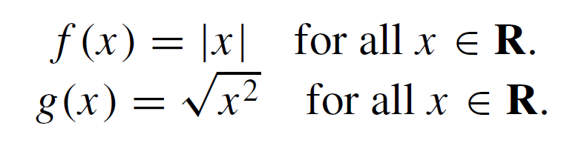
Example 7 – Equality of Functions
Define f : R → R and g: R → R by the following formulas:
Does f = g?
Solution:
Yes. Because the absolute value of any real number equals the square root of its square,

