Slide 1
Functions Defined on General Sets
Recall the definition of a function:
Definition: A function f from X to Y, denoted f: X → Y, is a relation (i.e., a subset of X × Y) in which each element of X is related to exactly one element in Y.
Terminology:
X is the domain
Y is the co-domain
The range of f is the set {y ∈ Y | ∃x ∈ X : y = f(x)}.
If f(x) = y, then y is the image of x under f, or the value of f at x,
and x is a preimage of y or an inverse image of y,
The inverse image of y = {x ∈ X | f(x) = y}.

Slide 2
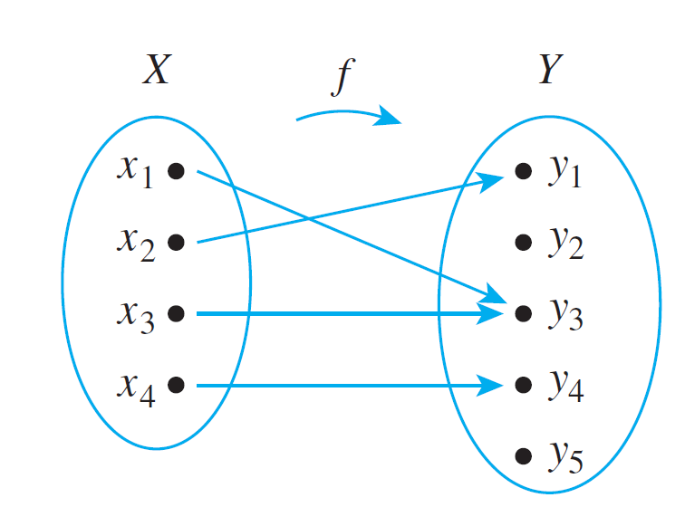
Arrow Diagrams
If X and Y are finite sets, you can define a function f from X to Y by drawing an arrow diagram.
You make a list of elements in X and a list of elements in Y, and draw an arrow from each element in X to the corresponding element in Y.

Slide 3
Arrow Diagrams
This arrow diagram does define a function because
1. Every element of X has an arrow coming out of it.
2. No element of X has two arrows coming out of it that point to two different elements of Y.

Slide 4
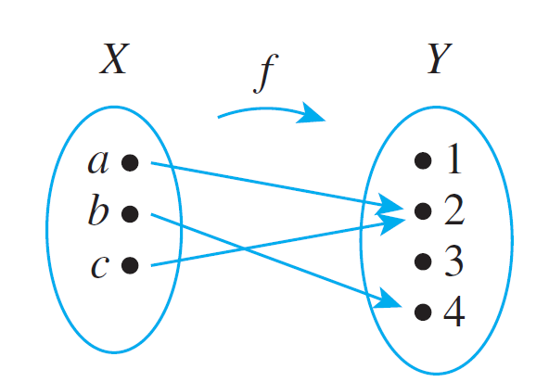
Example 2 – A Function Defined by an Arrow Diagram
Let X = {a, b, c} and Y = {1, 2, 3, 4}. Define a function f from X to Y by the arrow diagram below.
Write the domain and co-domain of f.
Domain is {a, b, c}.
Co-domain is {1, 2, 3, 4}.

Slide 5
Example 2 – A Function Defined by an Arrow Diagram
Let X = {a, b, c} and Y = {1, 2, 3, 4}. Define a function f from X to Y by the arrow diagram below.
Find f (a), f (b), and f (c).
f(a) = 2
f(b) = 4
f(c) = 2

Slide 6
Example 2 – A Function Defined by an Arrow Diagram
Let X = {a, b, c} and Y = {1, 2, 3, 4}. Define a function f from X to Y by the arrow diagram below.
What is the range of f ?
Range is {2, 4}.

Slide 7
Example 2 – A Function Defined by an Arrow Diagram
Let X = {a, b, c} and Y = {1, 2, 3, 4}. Define a function f from X to Y by the arrow diagram below.
Is c an inverse image of 2? Is b an inverse image of 3?
Yes, c is an inverse image of 2.
No, b is not an inverse image of 3.

Slide 8
Example 2 – A Function Defined by an Arrow Diagram
Let X = {a, b, c} and Y = {1, 2, 3, 4}. Define a function f from X to Y by the arrow diagram below.
Find the inverse images of 2, 4, and 1.
Inverse image of 2 is {a, c}.
Inverse image of 4 is {b}.
Inverse image of 1 is ∅.

Slide 9
Example 2 – A Function Defined by an Arrow Diagram
Let X = {a, b, c} and Y = {1, 2, 3, 4}. Define a function f from X to Y by the arrow diagram below.
Represent f as a set of ordered pairs.
f = { (a, 2), (b, 4), (c, 2) }

Slide 10
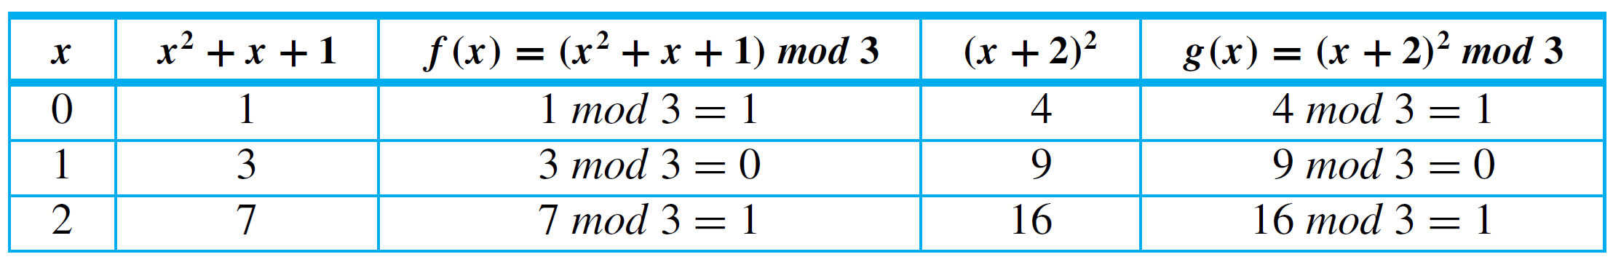
Example 3 – Equality of Functions
Let J₃ = {0, 1, 2}, and define functions f and g from J₃ to J₃ as follows: For all x in J₃,
Does f = g?
Yes, the table of values shows that f (x) = g(x) for all x in J₃.

Slide 11





Example 3 – Equality of Functions
Let F: R → R and G: R → R be functions. Define new functions F + G: R → R and G + F: R → R as follows: For all x ∈ R,
Does F + G = G + F?
Again the answer is yes. For all real numbers x,
Hence F + G = G + F.

Slide 12

Examples of Functions: The Identity Function
Given a set X, define a function I_{X} from X to X by
for all x in X.
The function I_{X} is called the identity function on X because it sends each element of X to the element that is identical to it.

Slide 13
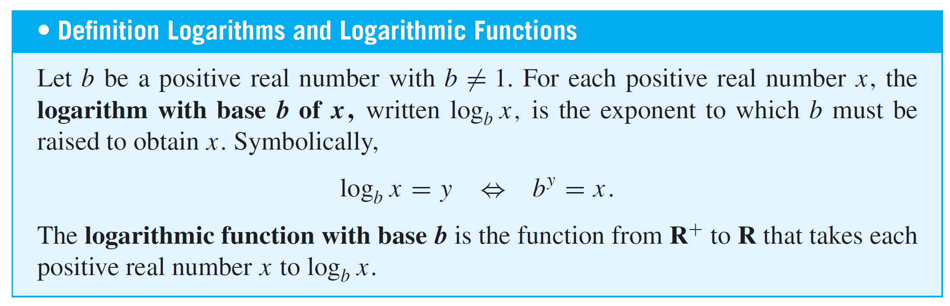
Examples of Functions: Logarithms
Examples:
log₃ 9 =
2 since 3² = 9
log₂ ½ =
−1 since 2⁻¹ = ½
log₁₀ 1 =
0 since 10⁰ = 1
2^{log2} ^{m} =
m

Slide 14
Examples of Functions
If S is a nonempty, finite set of characters, then a string over S is a finite sequence of elements of S.
The number of characters in a string is called the length of the string.
S^{l} denotes the set of all strings over S of length l.
The null string over S is the “string” with no characters.
It is usually denoted “ε” and is said to have length 0.

Slide 15

Example 9 – Encoding and Decoding Functions
Digital messages consist of finite sequences of 0’s and 1’s.
When they are communicated across a transmission channel, they are frequently coded in special ways to reduce the possibility that they will be garbled by interfering noise in the transmission lines.
For example, suppose a message consists of a sequence of 0’s and 1’s. A simple way to encode the message is to write each bit three times. Thus the message
would be encoded as

Slide 16
Example 9 – Encoding and Decoding Functions
cont’d
The encoding function E_{l} is the function from {0,1} ^{l} to {0,1}^{3l} defined as follows: For each string s ∈ {0,1}^{l},
E_{l}(s) = the string obtained from s by replacing each
bit of s by the same bit written three times.
The decoding function D_{l} is defined as follows: For each string t ∈ {0,1}^{3l},
D_{l} (t) = the string obtained from t by replacing each consecutive triple of three bits of t by their majority bit.

Slide 17
Example 9 – Encoding and Decoding Functions
cont’d
The advantage of this particular coding scheme is that it makes it possible to do a certain amount of error correction when interference in the transmission channels has introduced occasional errors into the stream of bits.

Slide 18
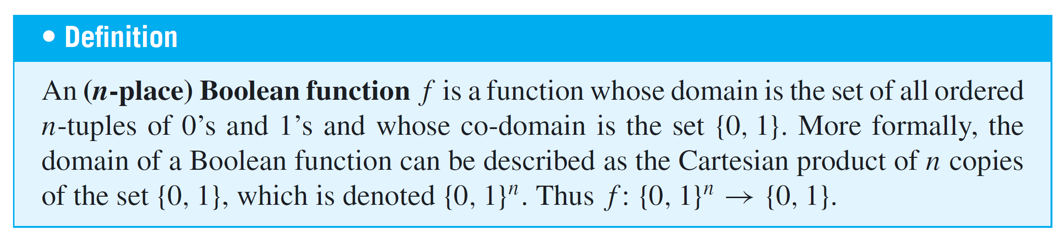
Boolean Functions

Slide 19
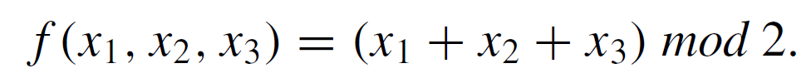
Example 11 – A Boolean Function
Consider the three-place Boolean function defined from the set of all 3-tuples of 0’s and 1’s to {0, 1} as follows: For each triple (x₁, x₂, x₃) of 0’s and 1’s,
Describe f using an input/output table.
Solution:

Slide 20
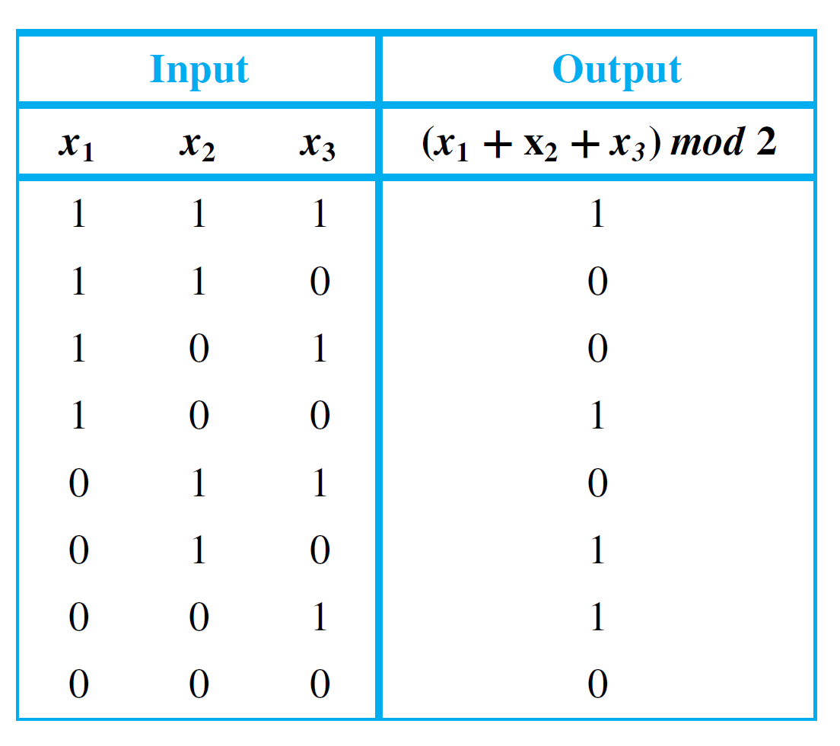
Example 11 – Solution
cont’d
The rest of the values of f can be calculated similarly to obtain the following table.

Slide 21
Checking Whether a Function Is Well Defined
It can sometimes happen that what appears to be a function defined by a rule is not really a function at all. To give an example, suppose we wrote, “Define a function
f : R → R by specifying that for all real numbers x,
This does not define a function, since for almost all values of x, either
there is no y that satisfies the given equation or
there are two different values of y that satisfy the equation.

Slide 22
Checking Whether a Function Is Well Defined
For instance,
when x = 2, there is no real number y such that 2² + y² = 1, and
when x = 0, both y = –1 and y = 1 satisfy the equation 0² + y² = 1.
In general, we say that a “function” is not well defined if it fails to satisfy the requirements for being a function.

Slide 23
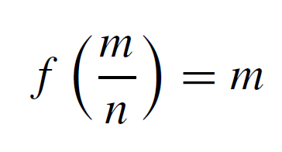

Example 12 – A Function That Is Not Well Defined
We know that Q represents the set of all rational numbers. Suppose you read that a function f : Q → Z is to be defined by the formula
for all integers m and n with n ≠ 0.
That is, the integer associated by f to the number is m. Is f well defined? Why?

Slide 24
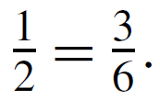
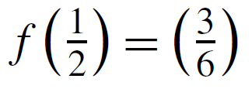
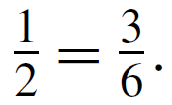
Example 12 – Solution
The function f is not well defined.
The reason is that fractions have more than one representation as quotients of integers.
For instance, Now if f were a function, then the
definition of a function would imply that since

Slide 25
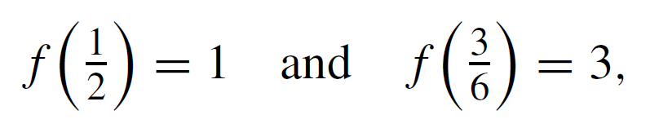
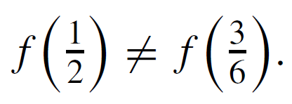
Example 12 – Solution
cont’d
But applying the formula for f, you find that
and so
This contradiction shows that f is not well defined and, therefore, is not a function.

Slide 26
Checking Whether a Function Is Well Defined
Note that the phrase well-defined function is actually redundant; for a function to be well defined really means that it is worthy of being called a function.

Slide 27
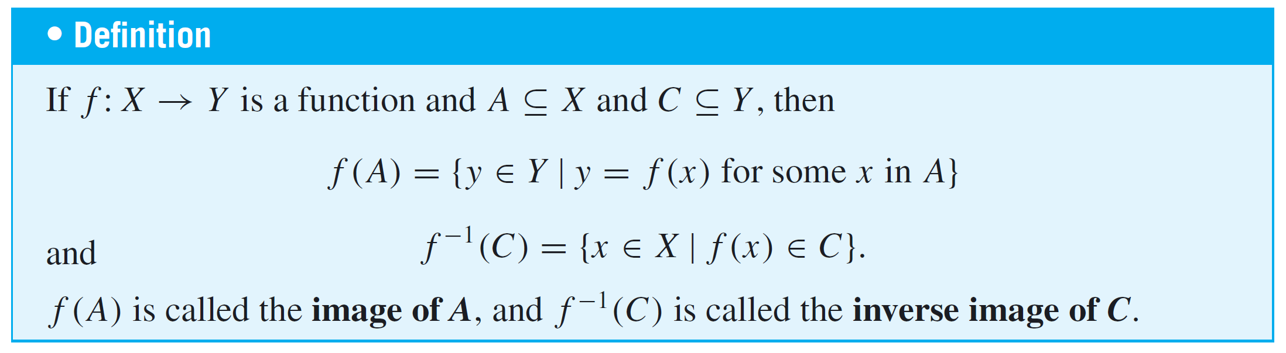
Functions Acting on Sets
Given a function from a set X to a set Y, you can consider
the set of images in Y of all the elements in a subset of X and
the set of inverse images in X of all the elements in a subset of Y.

Slide 28
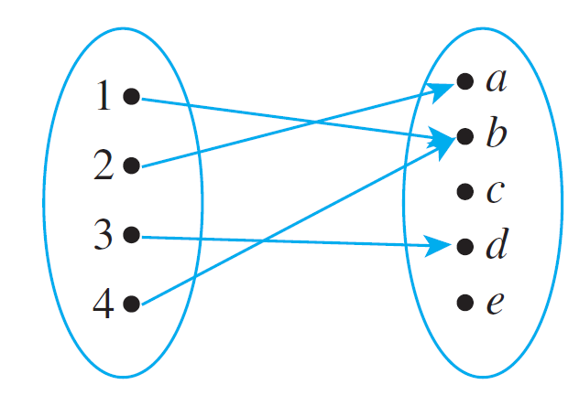
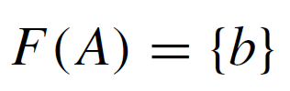
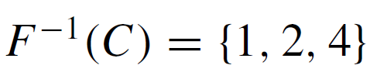


Example 13 – The Action of a Function on Subsets of a Set
Let X = {1, 2, 3, 4} and Y = {a, b, c, d, e}, and define
F : X → Y by the following arrow diagram:
Let A = {1, 4}, C = {a, b}, and D = {c, e}. Find F(A), F(X), F⁻¹(C), and F⁻¹(D).

